Slide 1
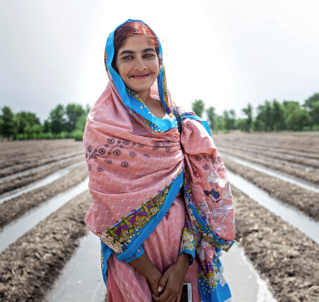
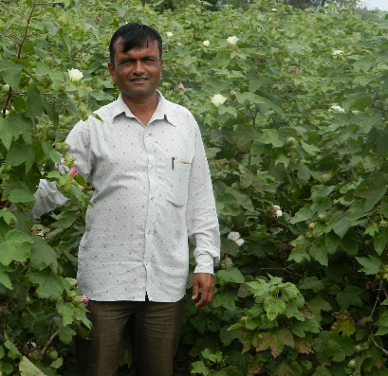
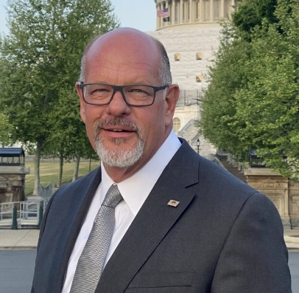
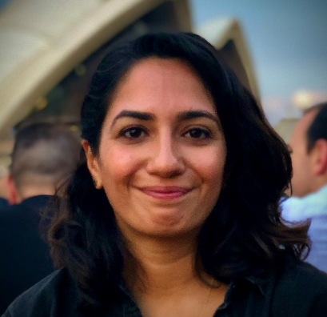
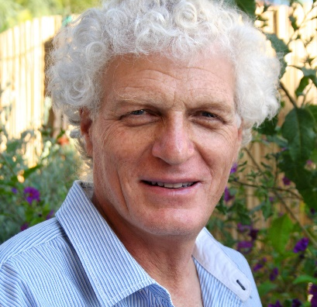
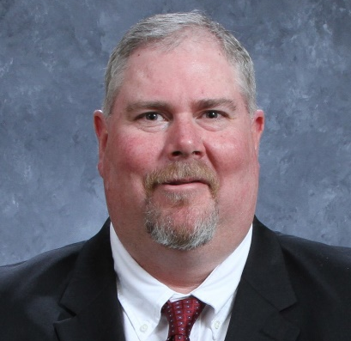
Opportunities and Challenges at Farm-level Plenary
Thursday 22 June
With Speakers:
Facilitator:
Almas Parveen Farmer & Project Officer, REEDS
Rasikbhai Danabhai Poriya Farmer, Ambuja Cement Foundation
Steve Olson Producer, ​Cindy Olson Farms Partnership
Amna Bajwa Programme Coordinator, Better Cotton
Jonathan Spenser Project Officer, Israel Cotton Board
Todd Straley Managing​ Partner, Quaterway Cotton Growers

Slide 2
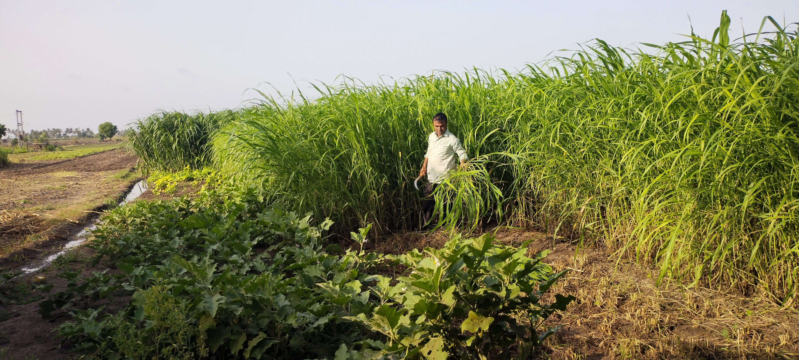
Notes:
Rasikbhai

Slide 3
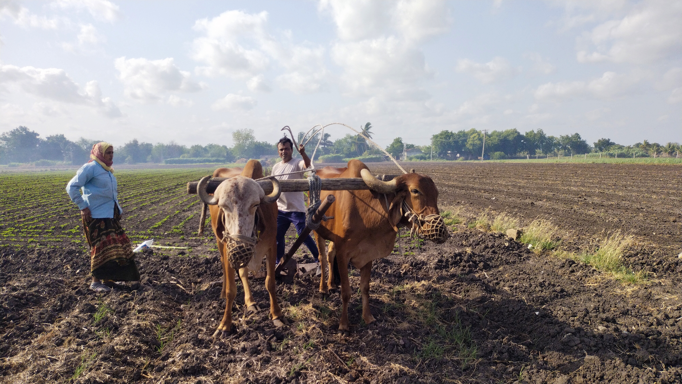
Notes:
Rasikbhai

Slide 4
Notes:
Rasikbhai

Slide 6
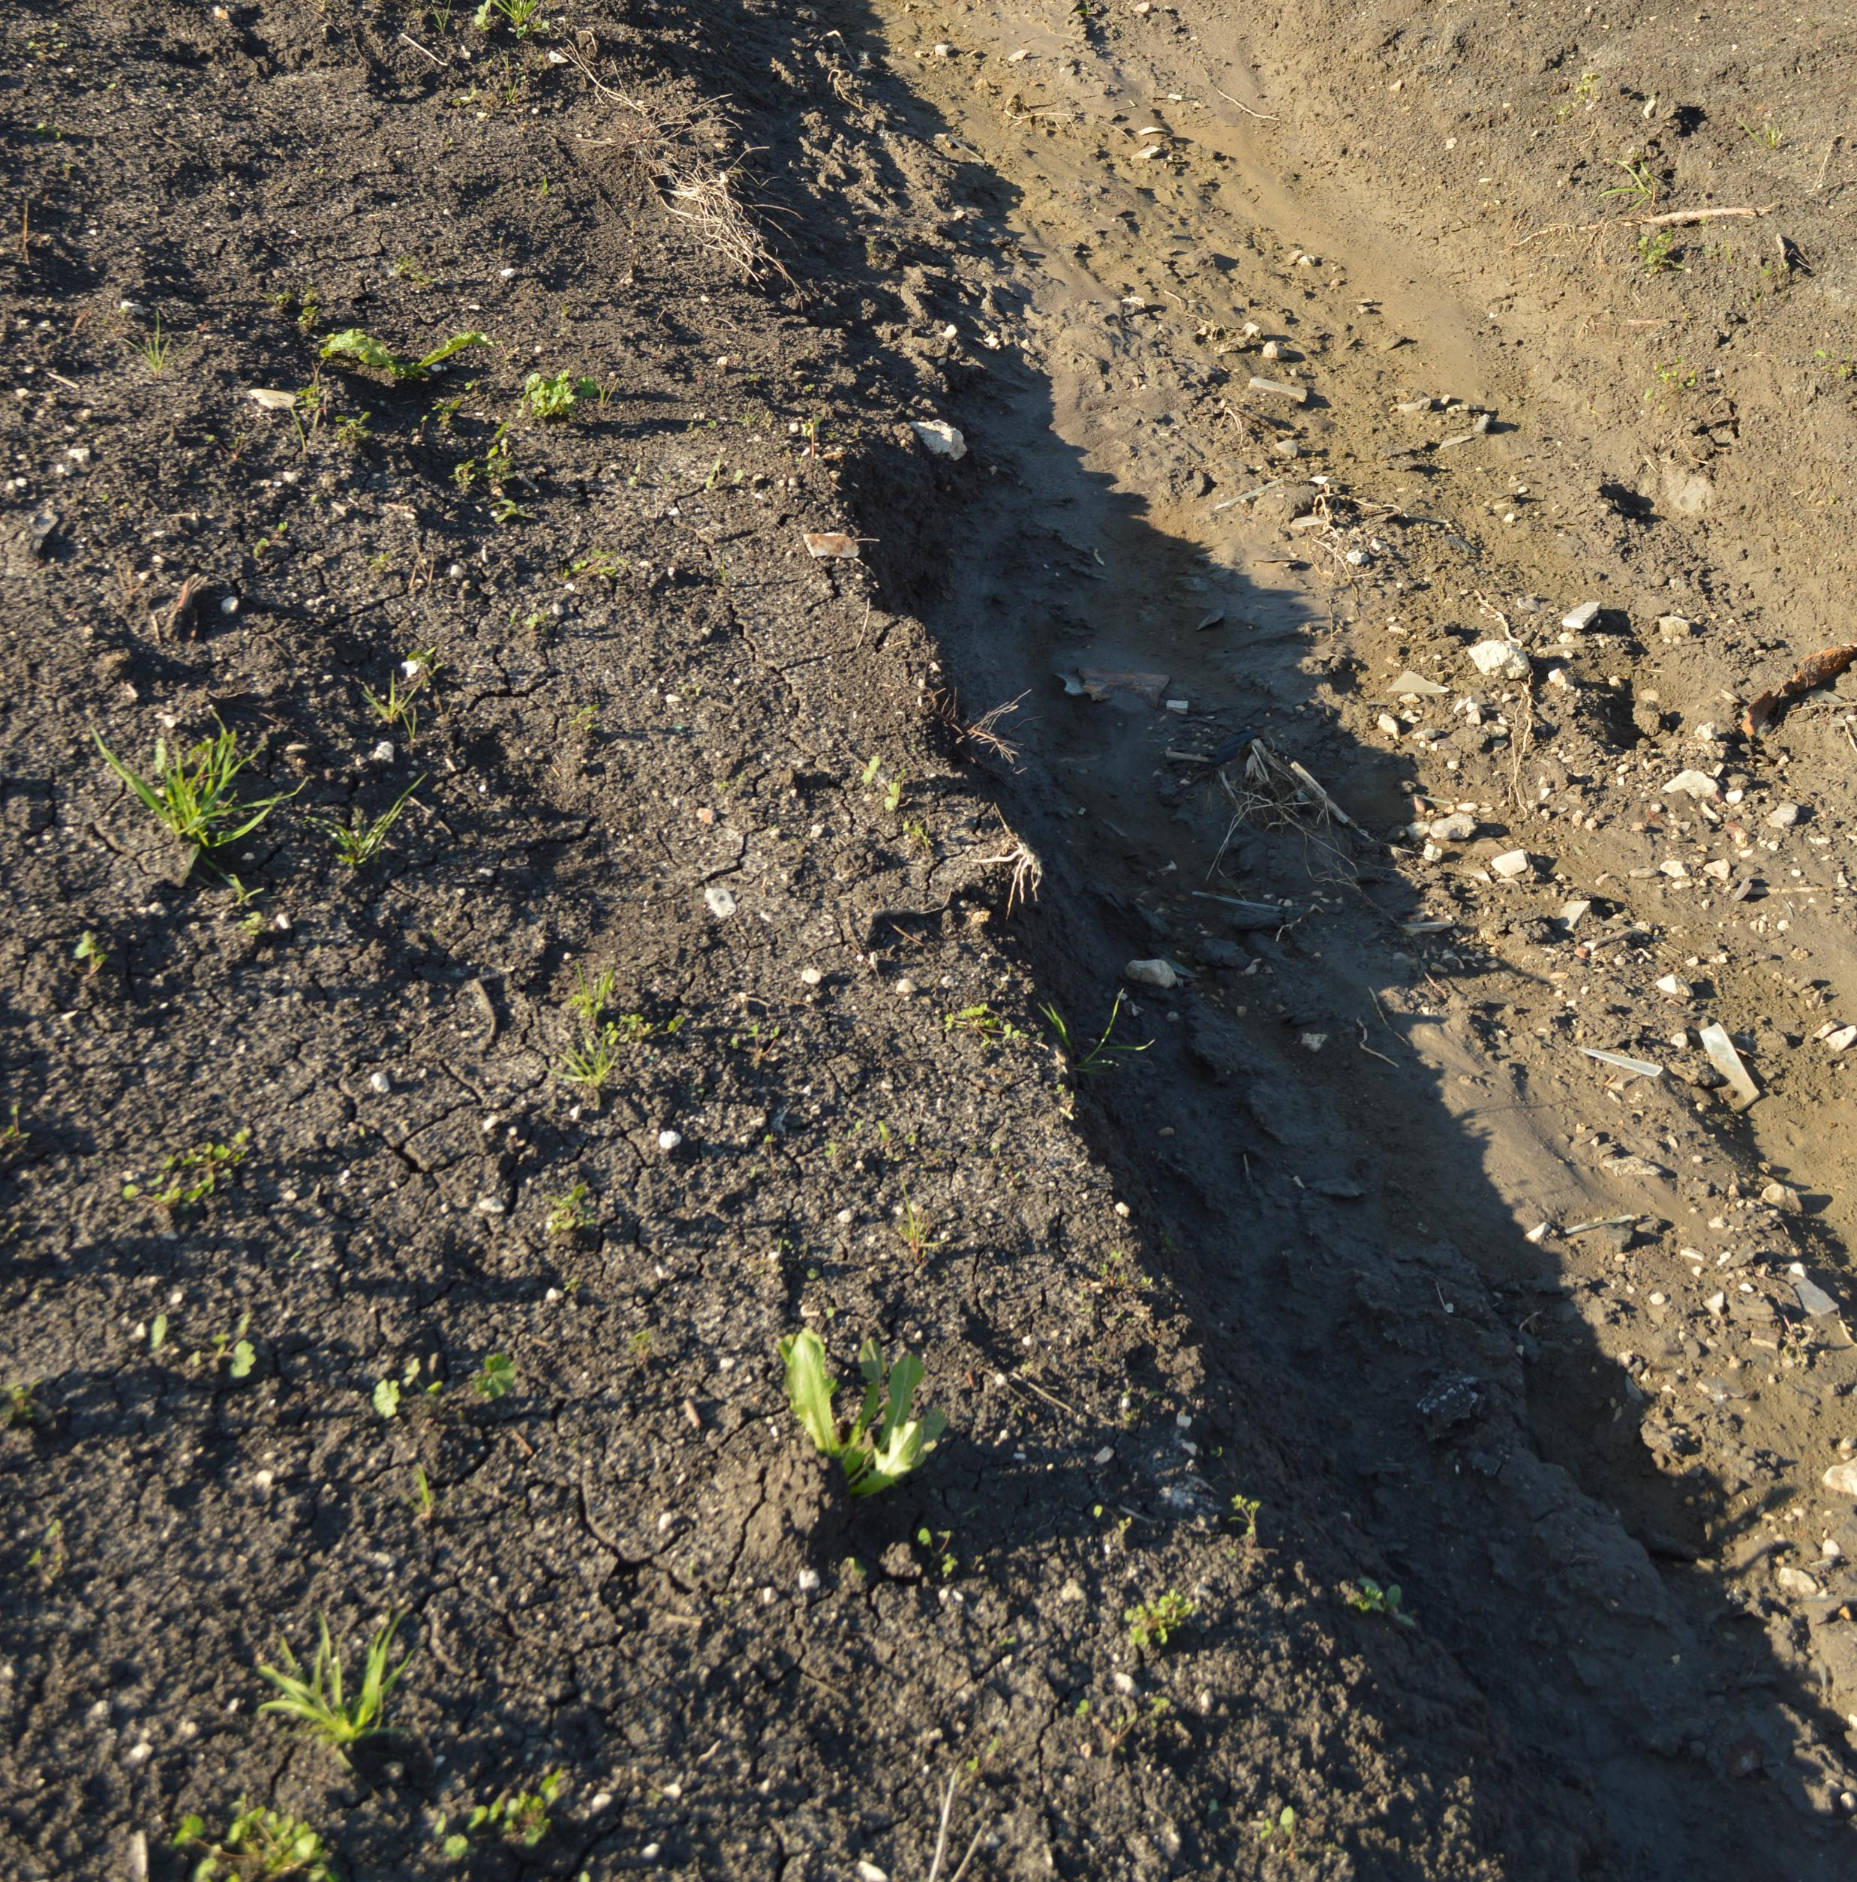
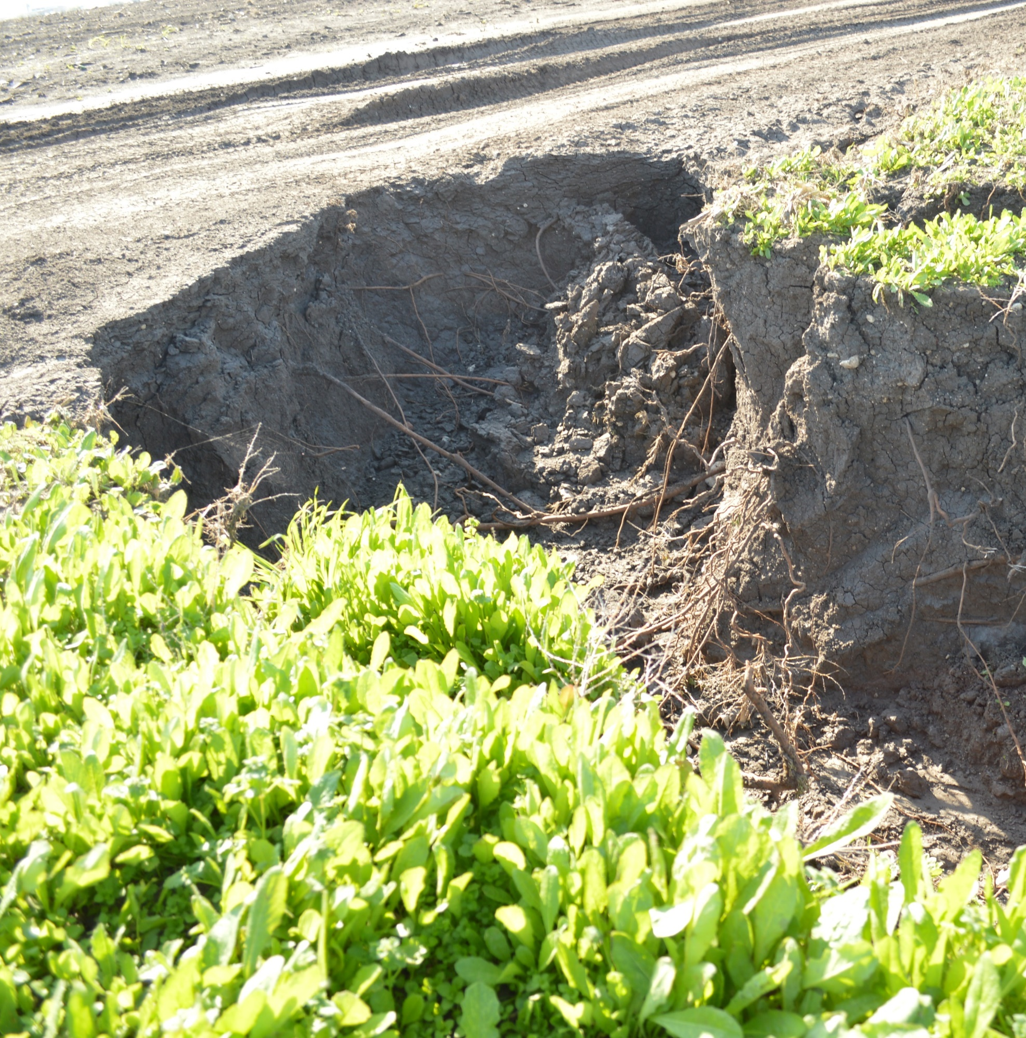
Notes:
Jonathan

Slide 7
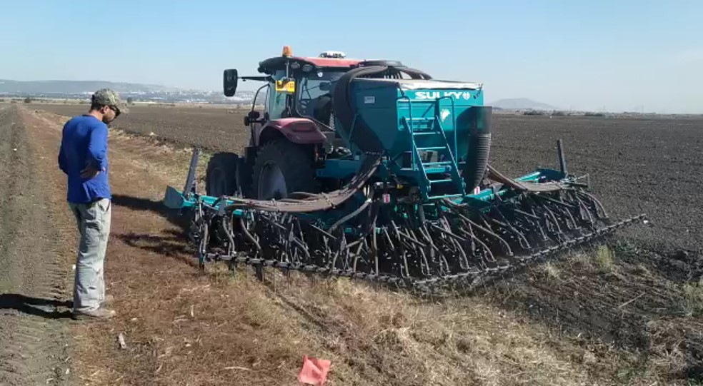
Notes:
Jonathan

Slide 8
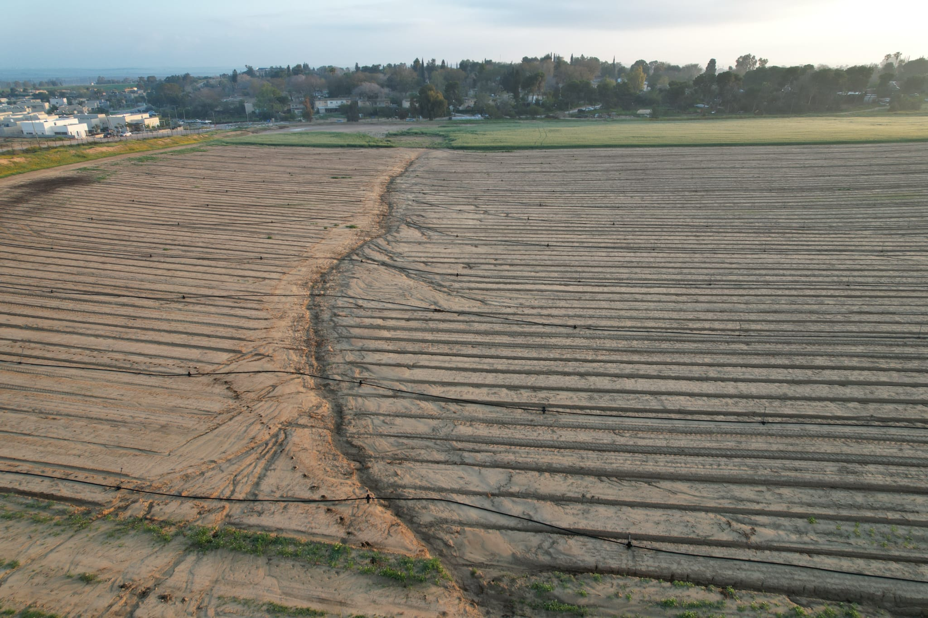
Notes:
Jonathan

Slide 9
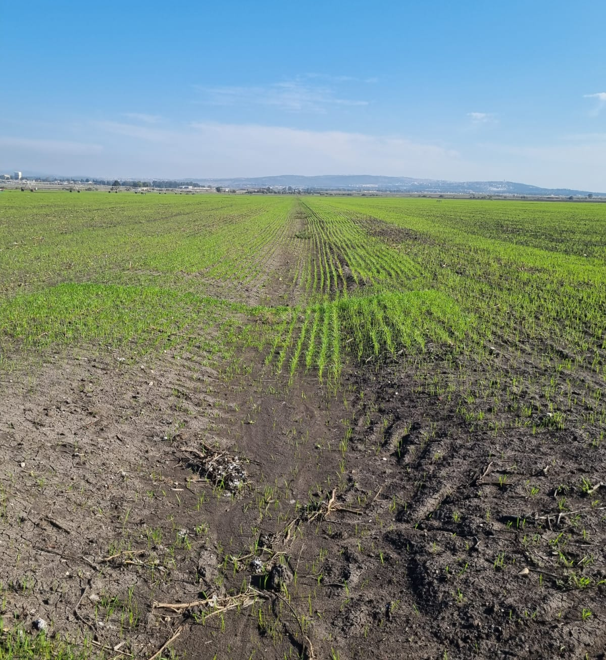

Slide 10
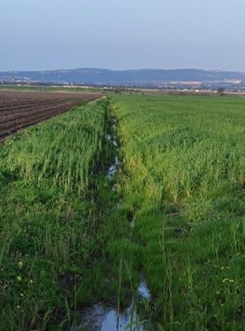
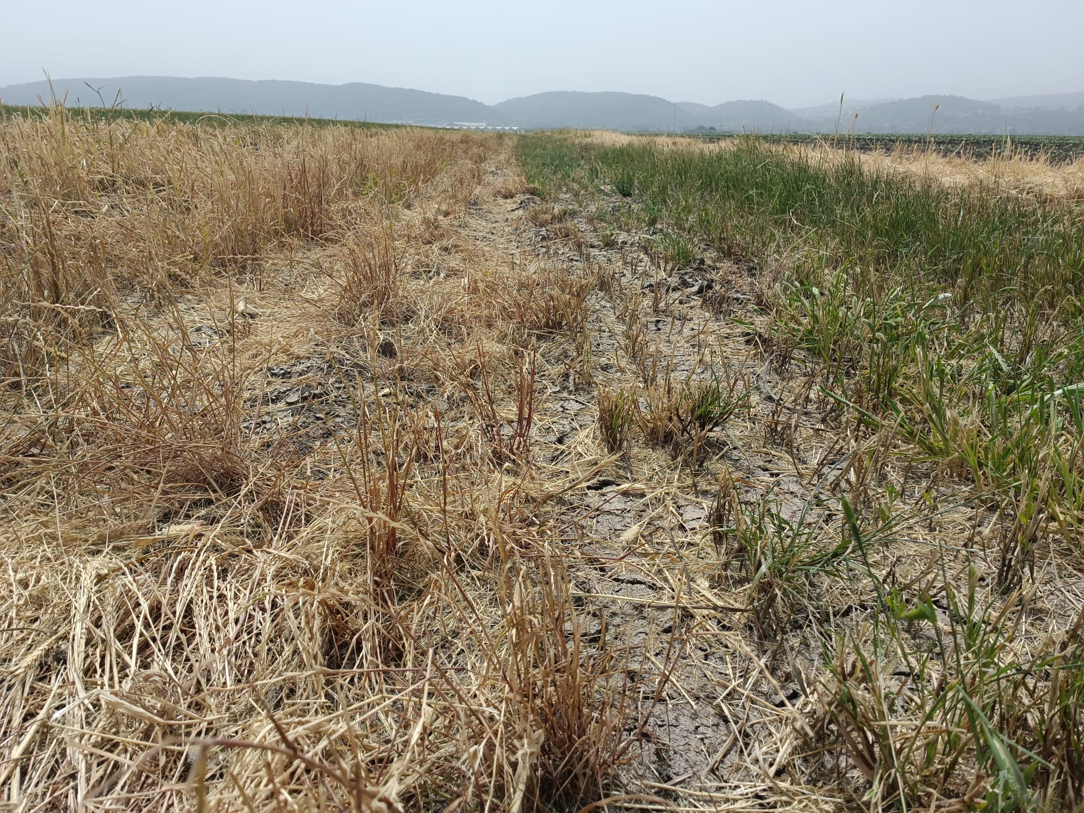
Notes:
Jonathan

Slide 11
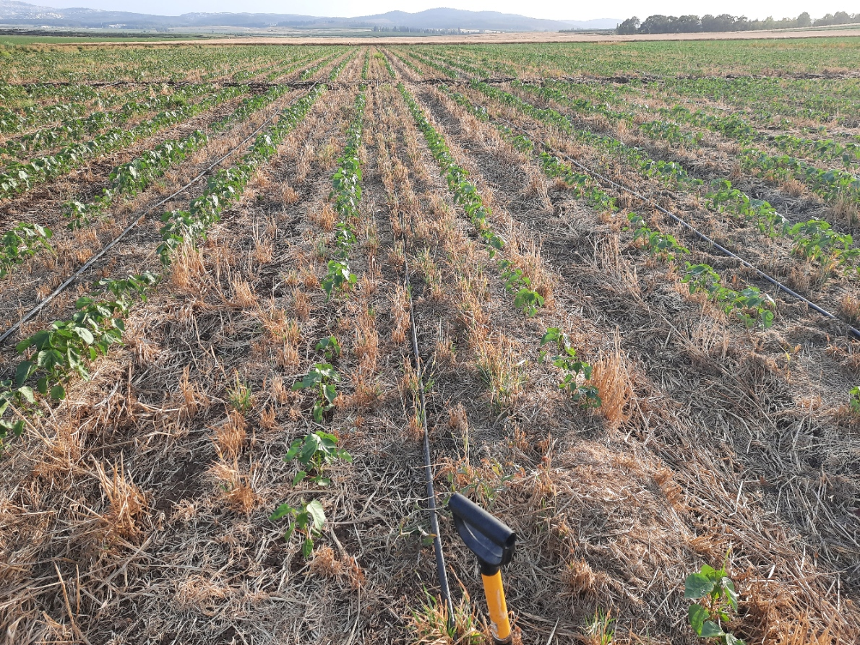
Notes:
Jonathan

Slide 12
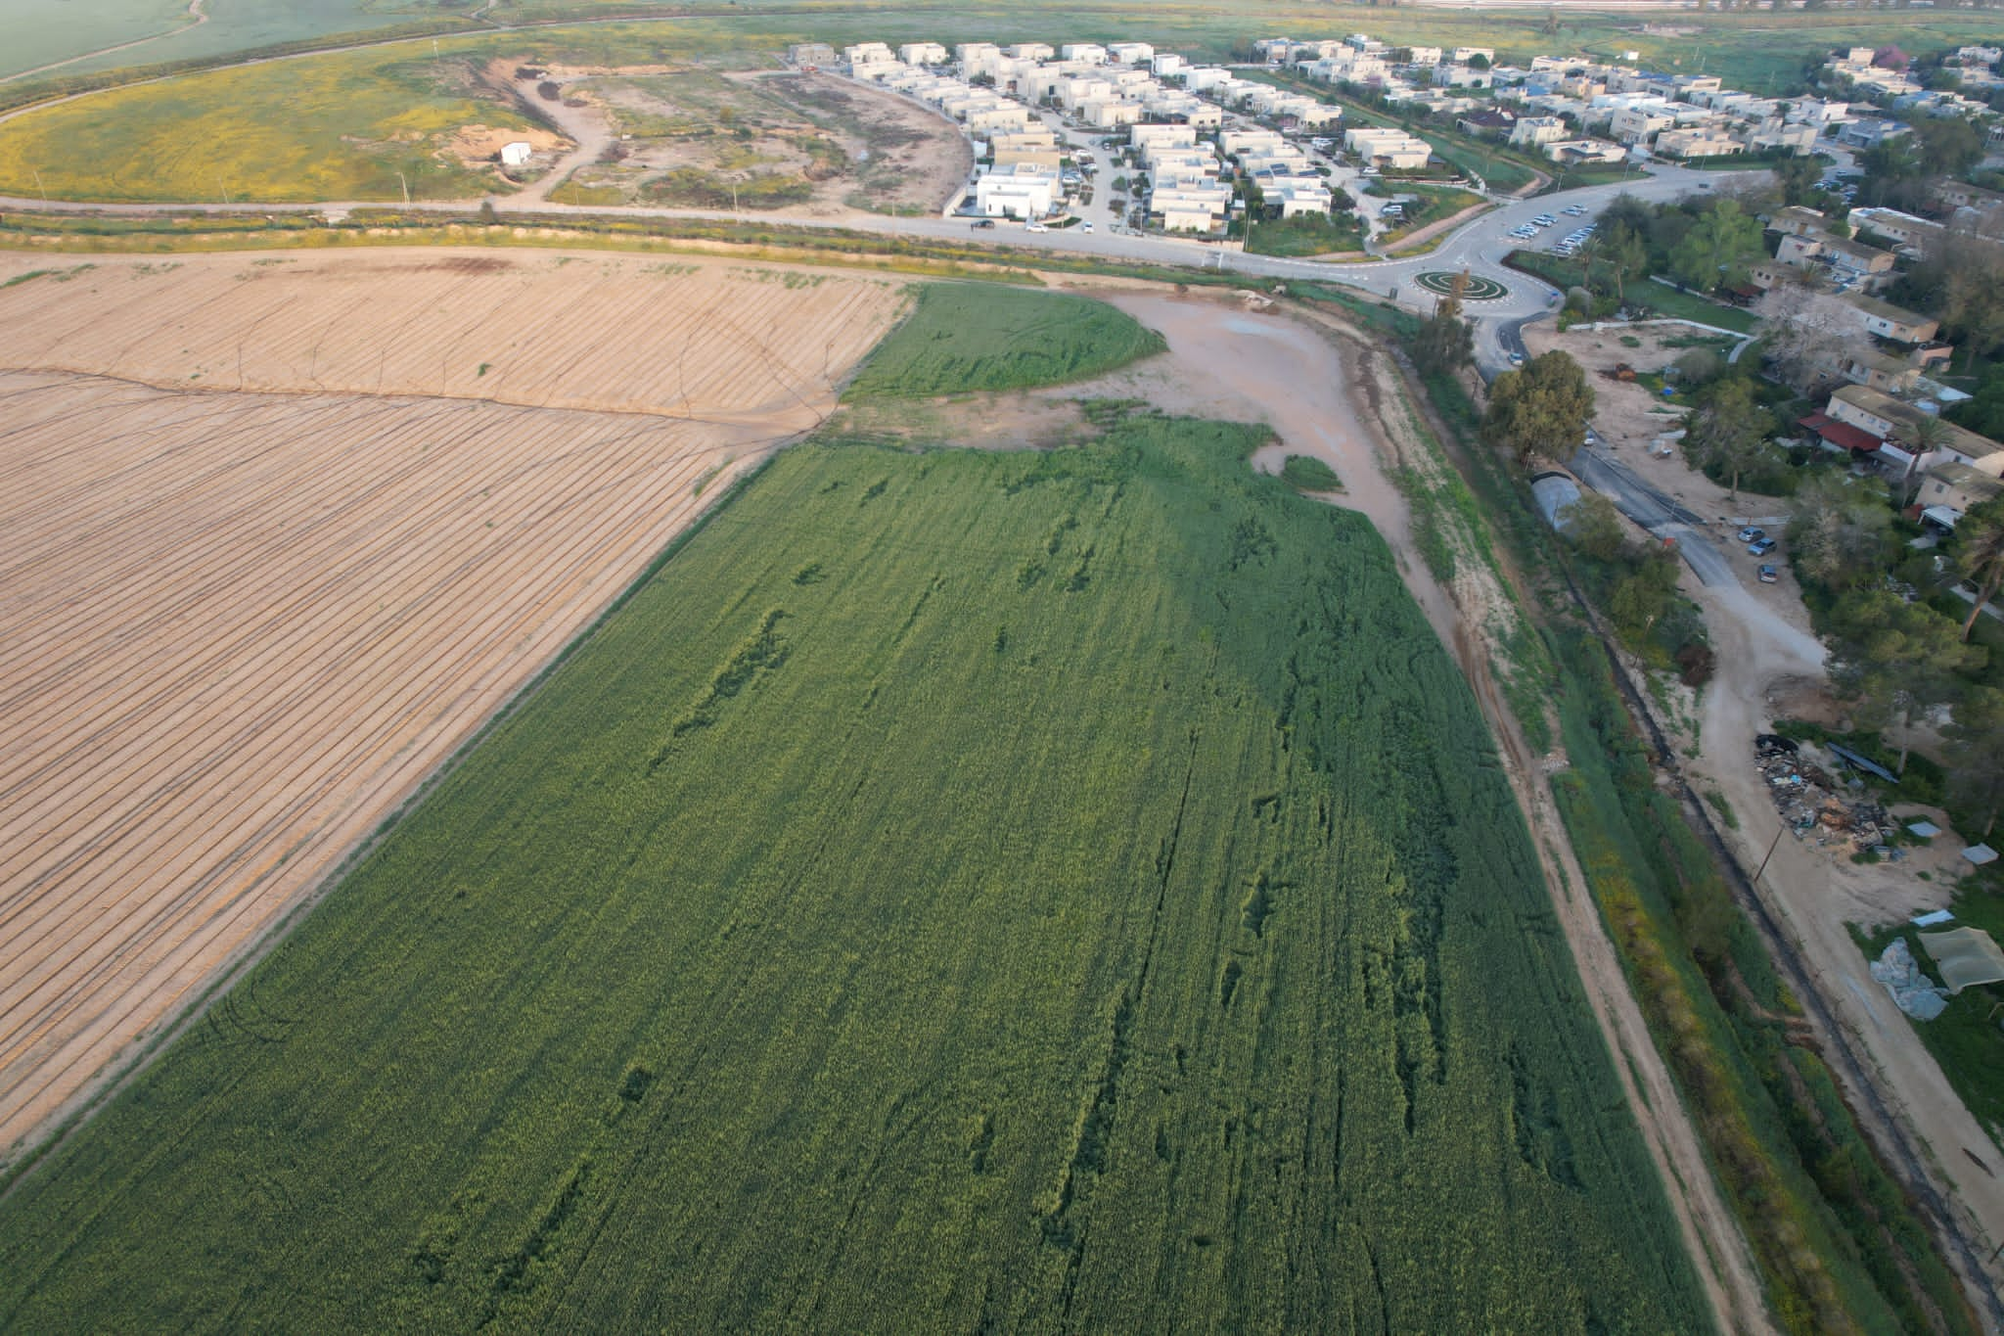
Notes:
Jonathan

