Slide 1















Member Meeting
21-22 JUNE 2023 | AMSTERDAM & ONLINE

Slide 2
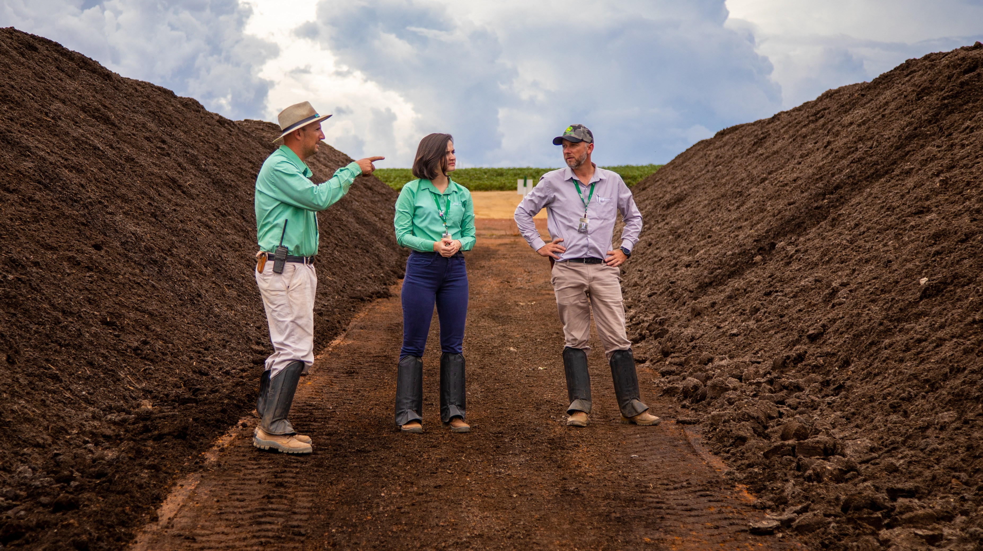
Notes:
India

Slide 3
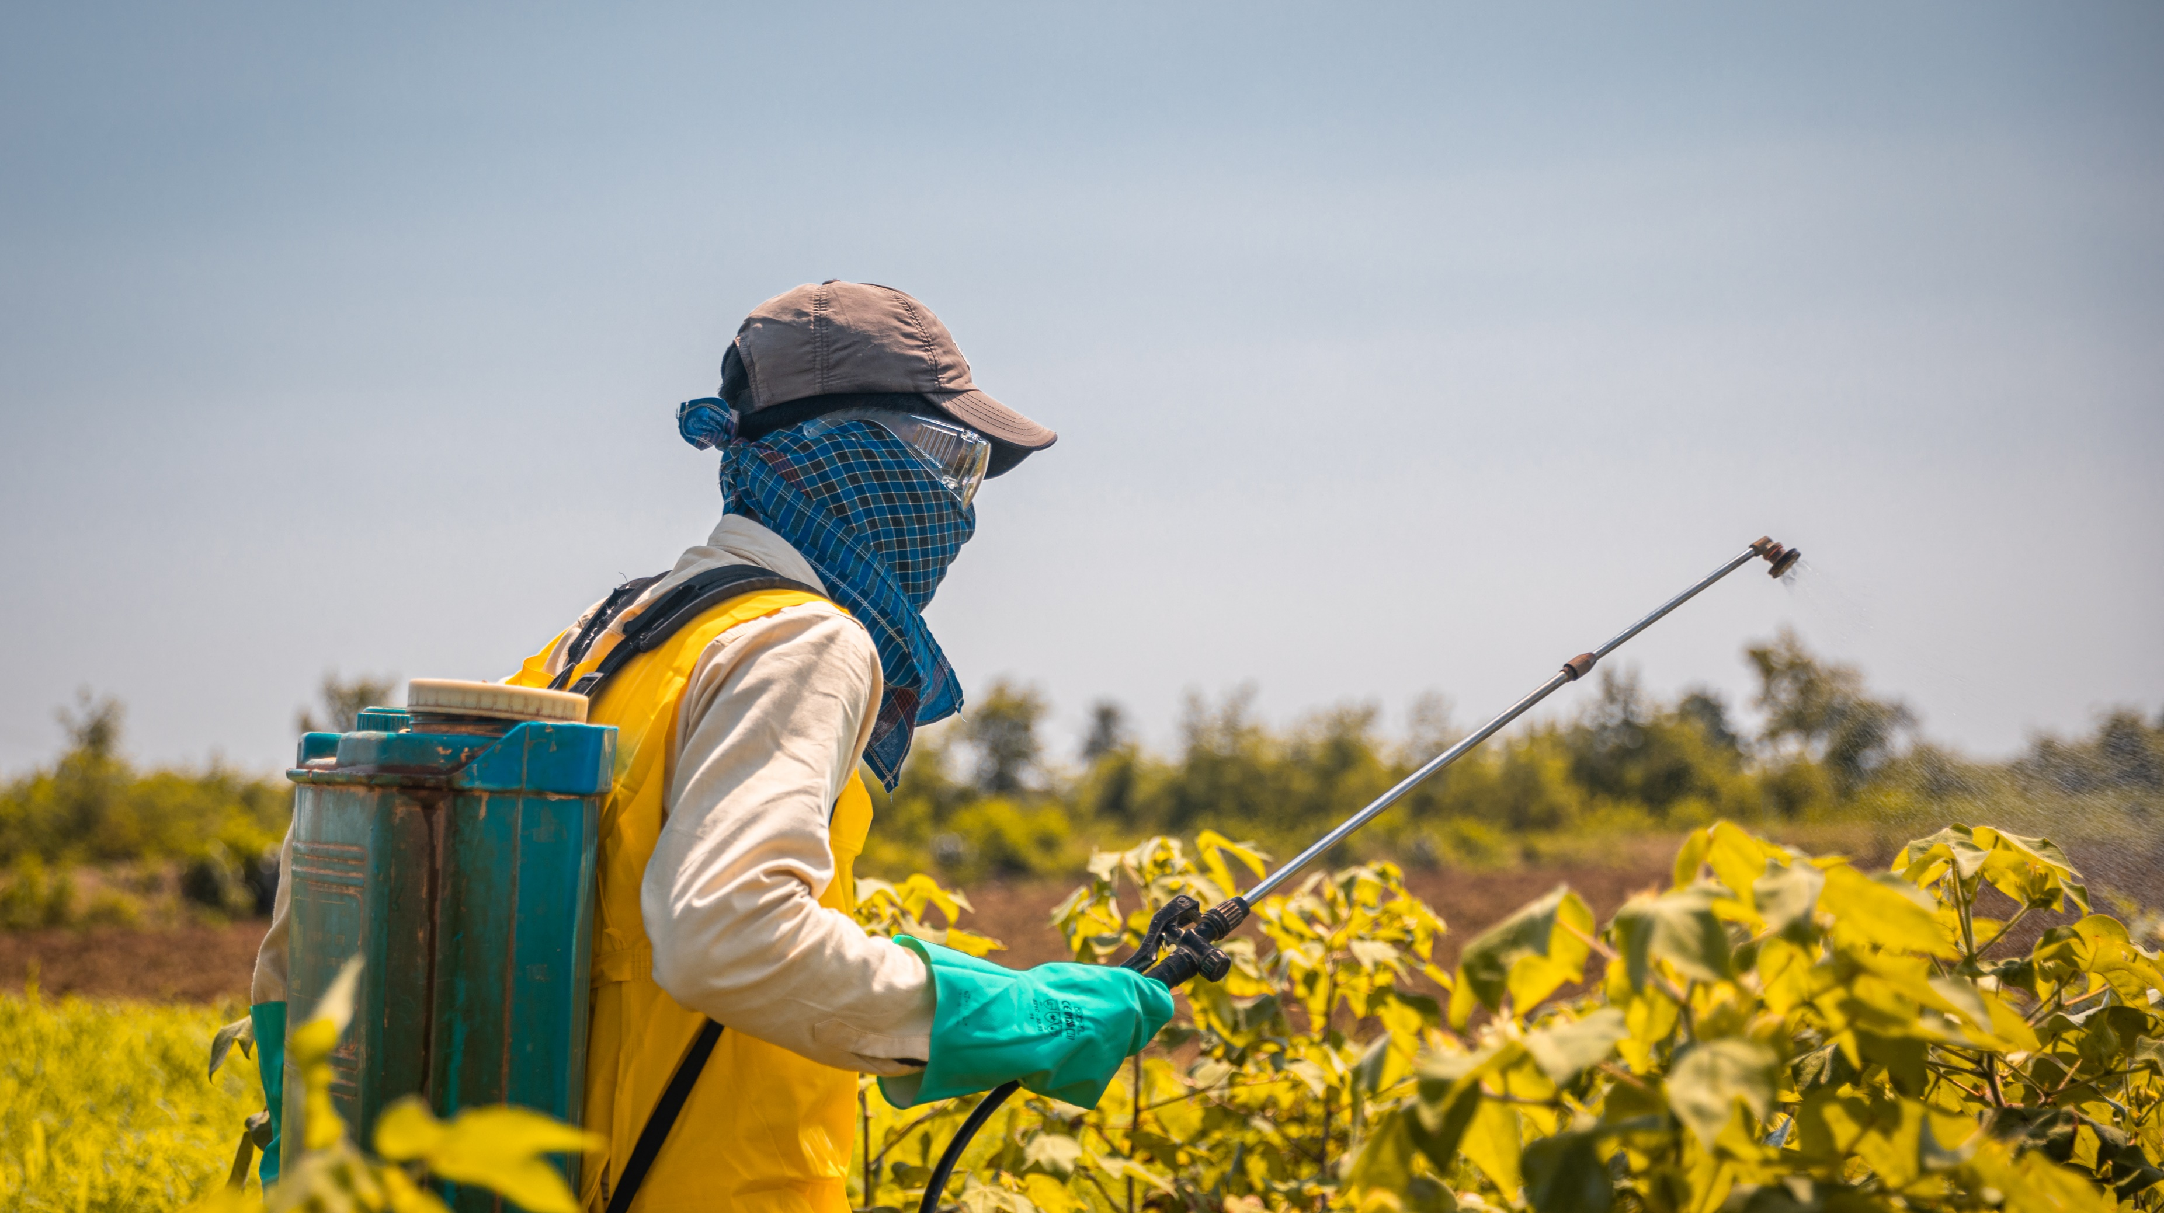
Notes:
India

Slide 4
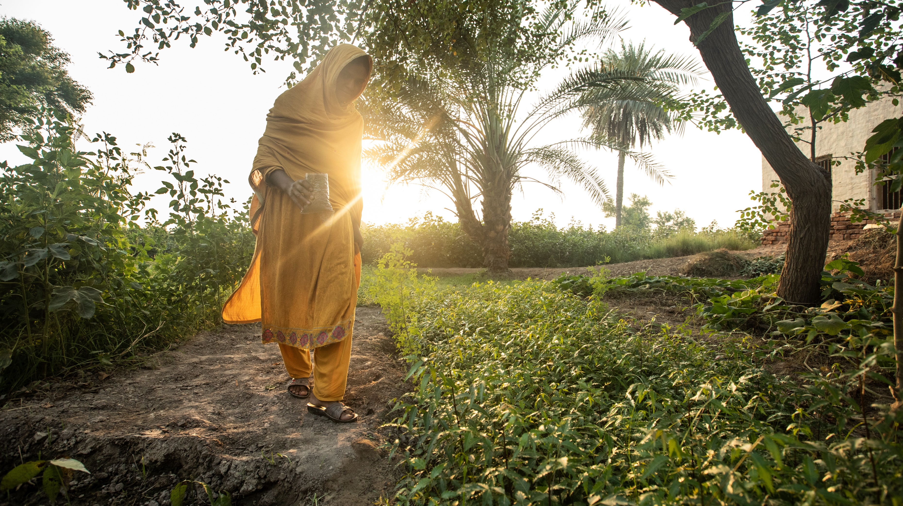

Slide 5
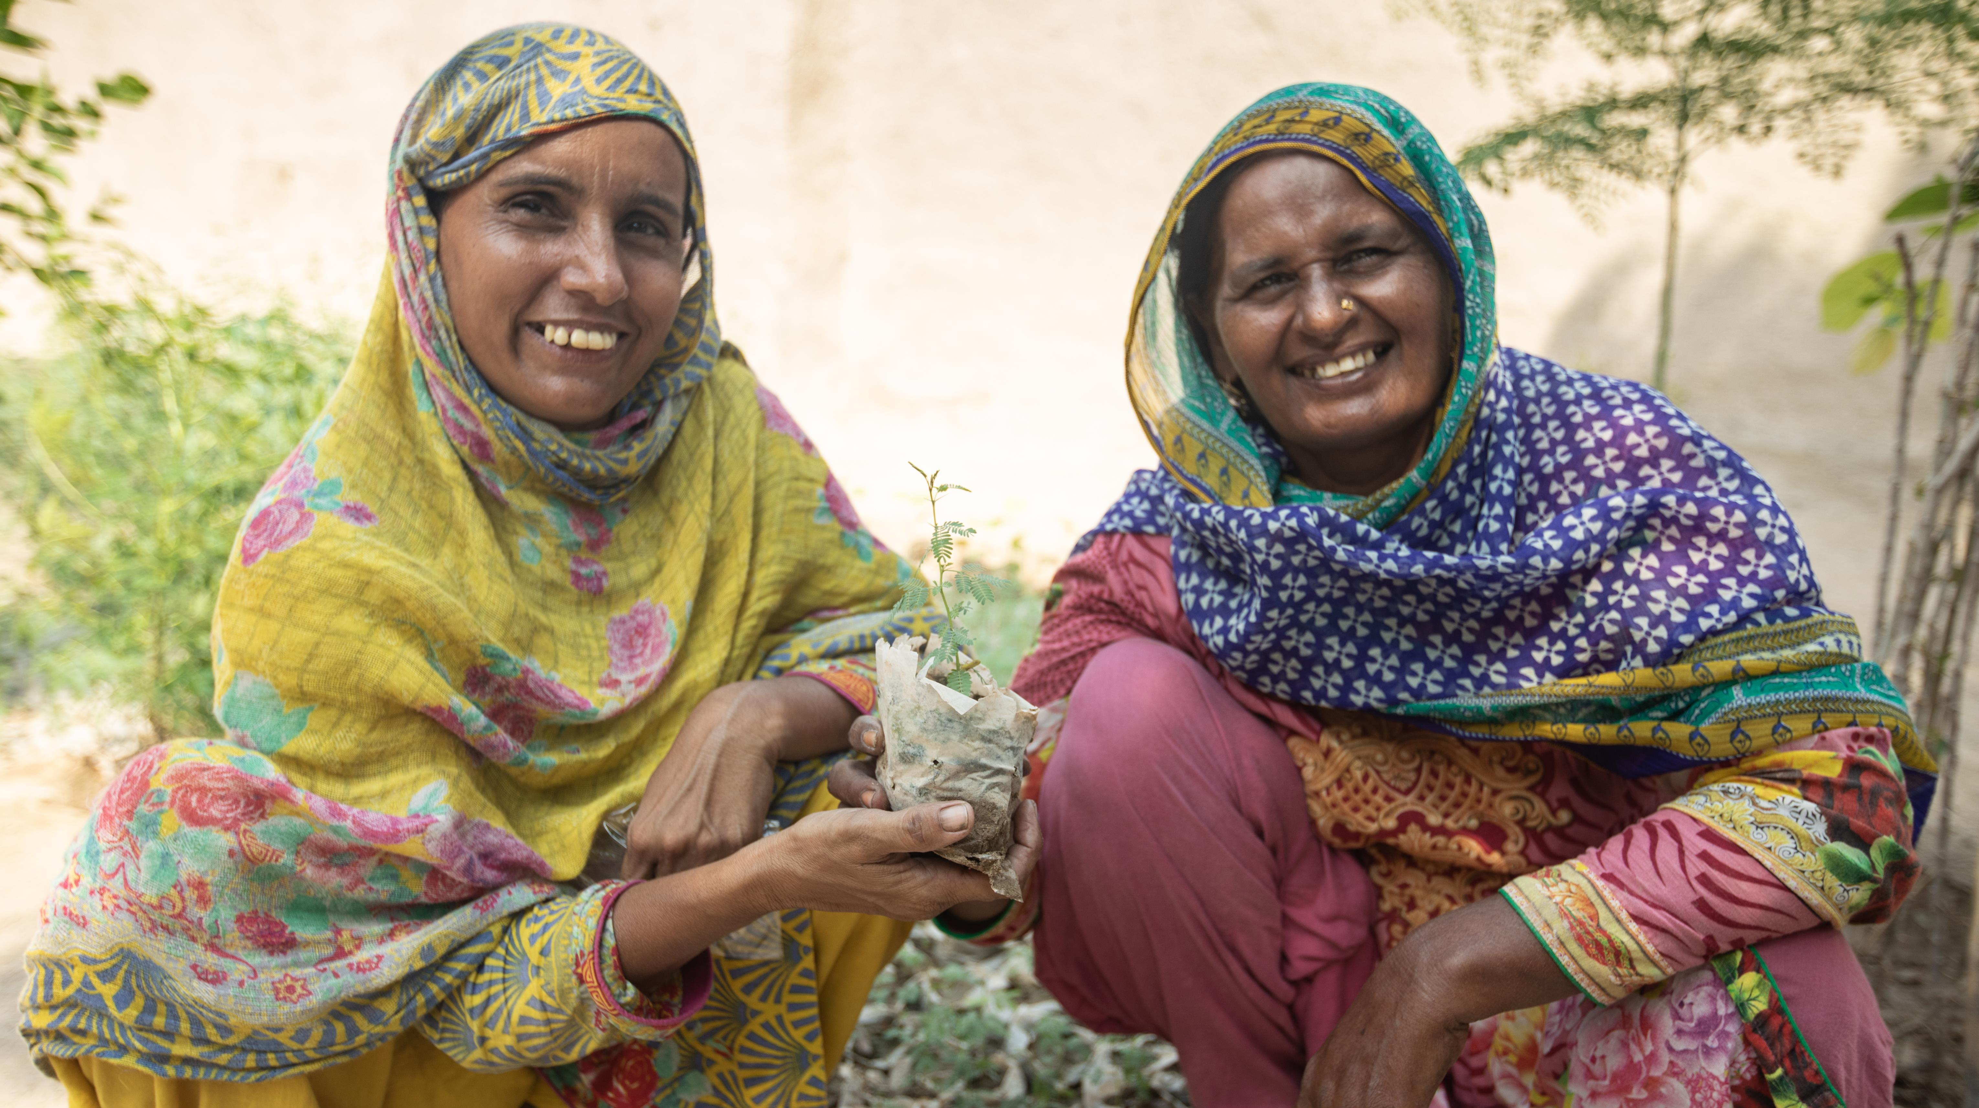
Notes:
Pakistan

Slide 6
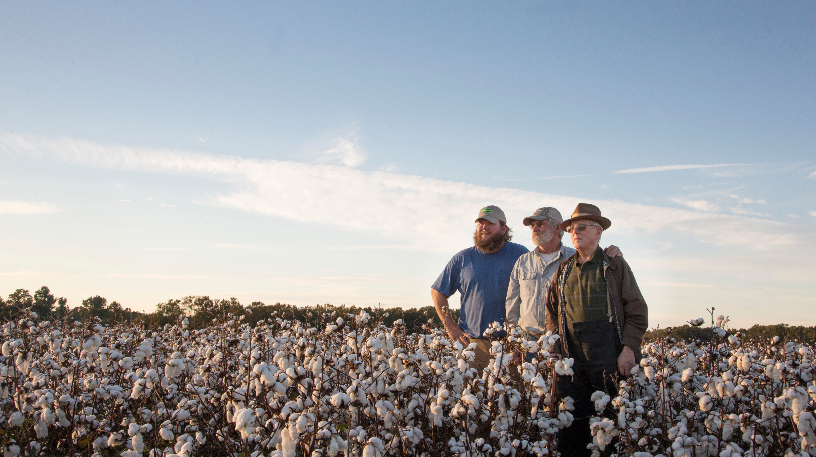
Notes:
Pakistan

Slide 7
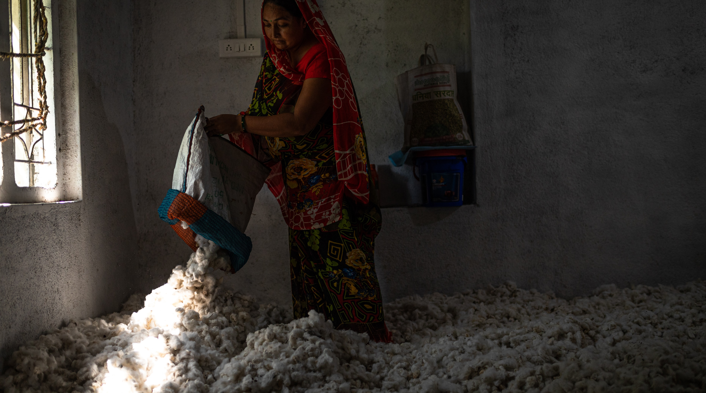
Notes:
India

Slide 8
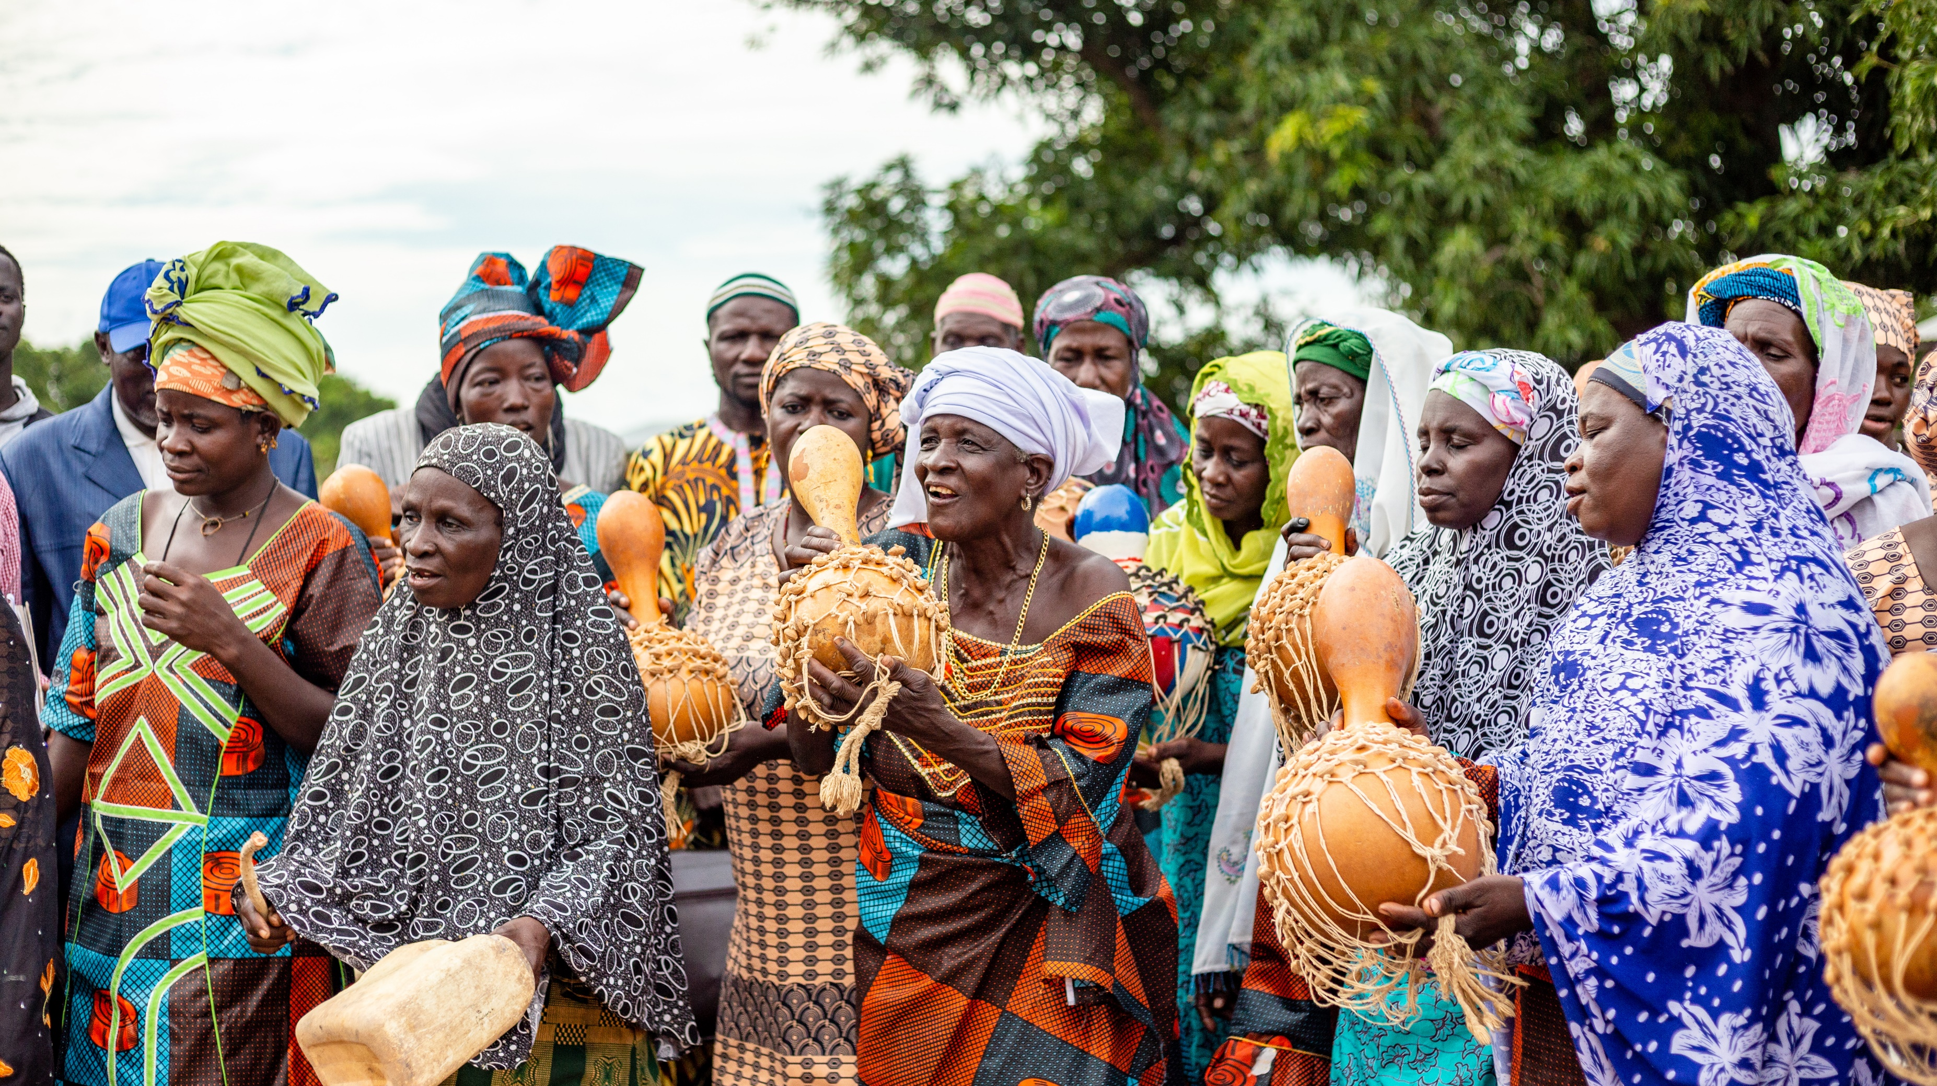
Notes:
Mali

Slide 9
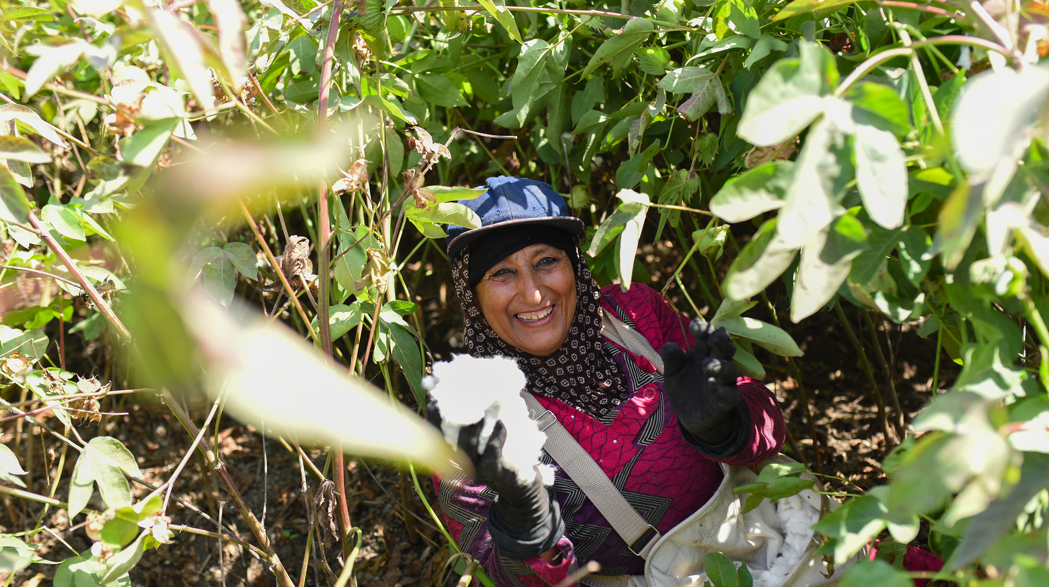
Notes:
Egypt

Slide 10
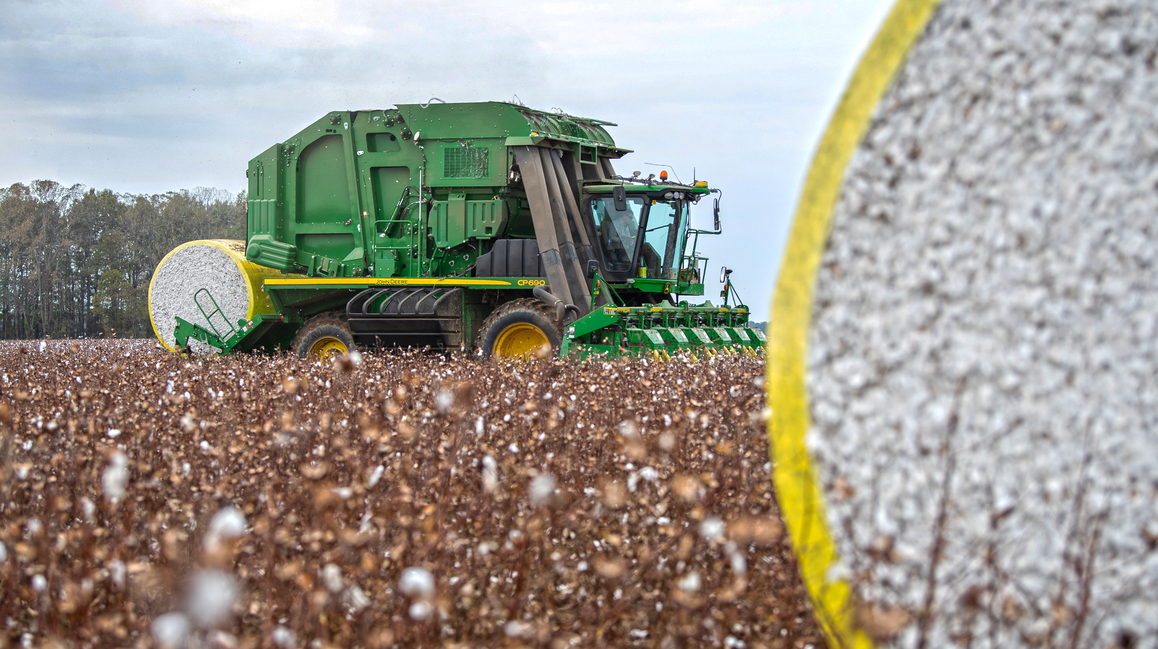
Notes:
Egypt

Slide 11
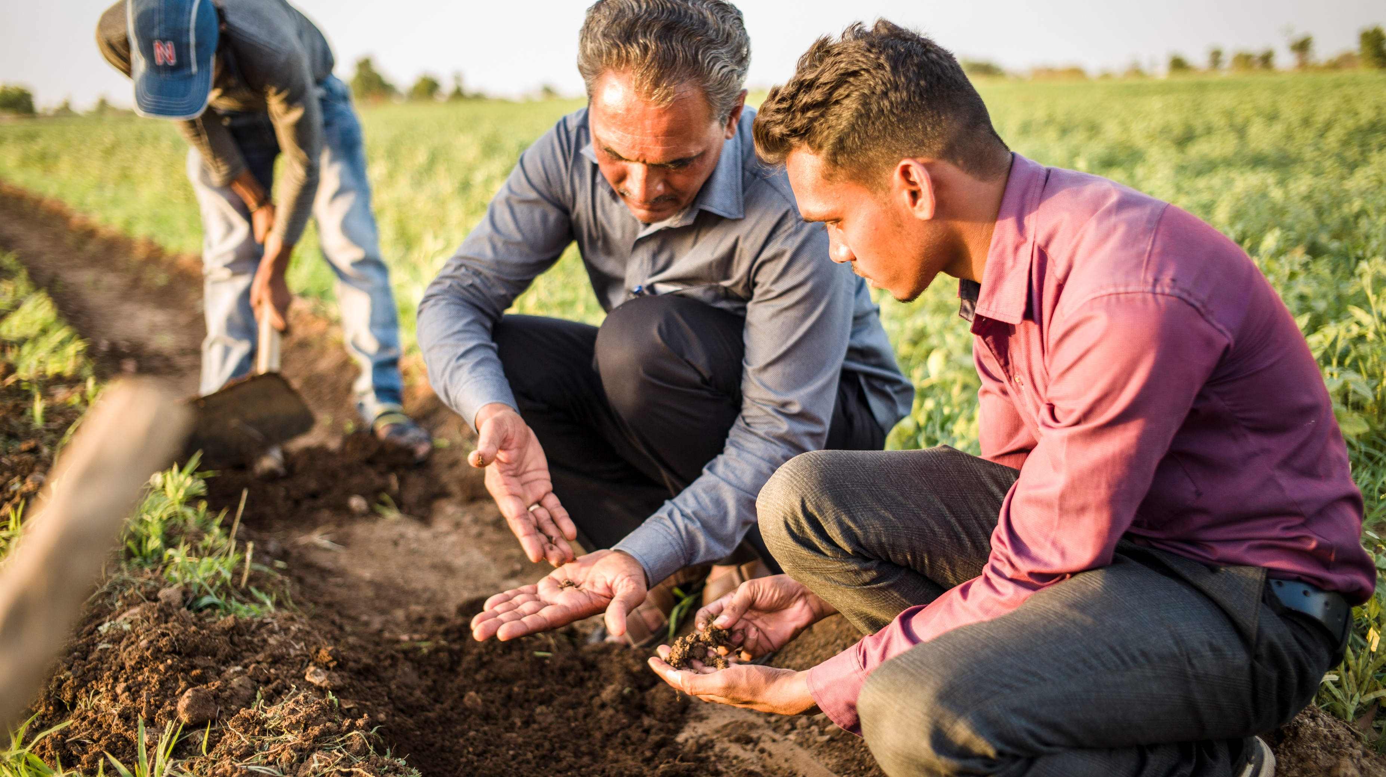
Notes:
India

Slide 12
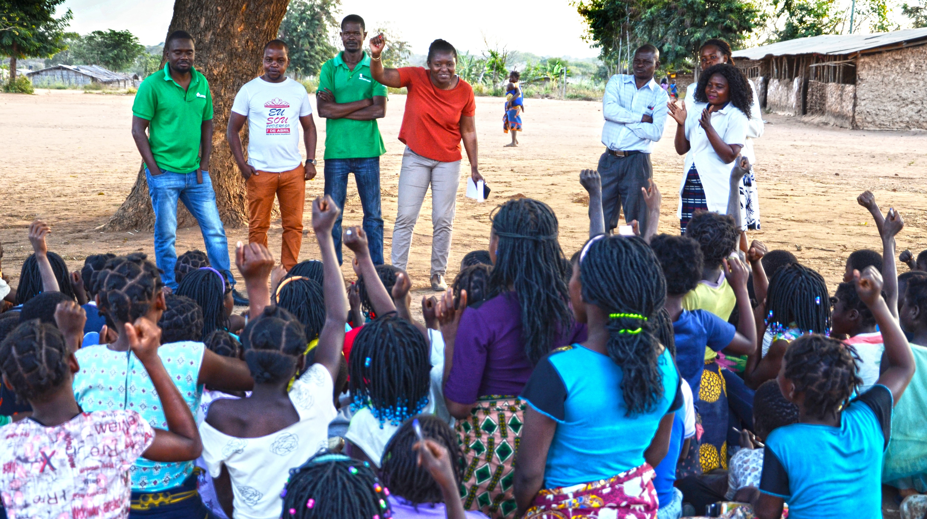
Notes:
Mozambique

Slide 13
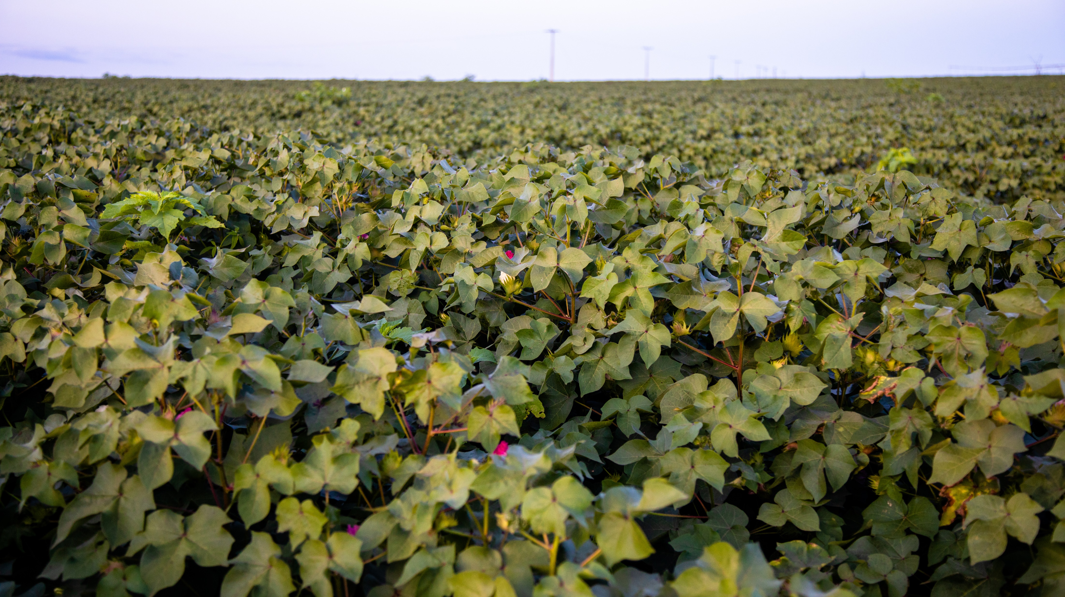
Notes:
Mozambique

Slide 14
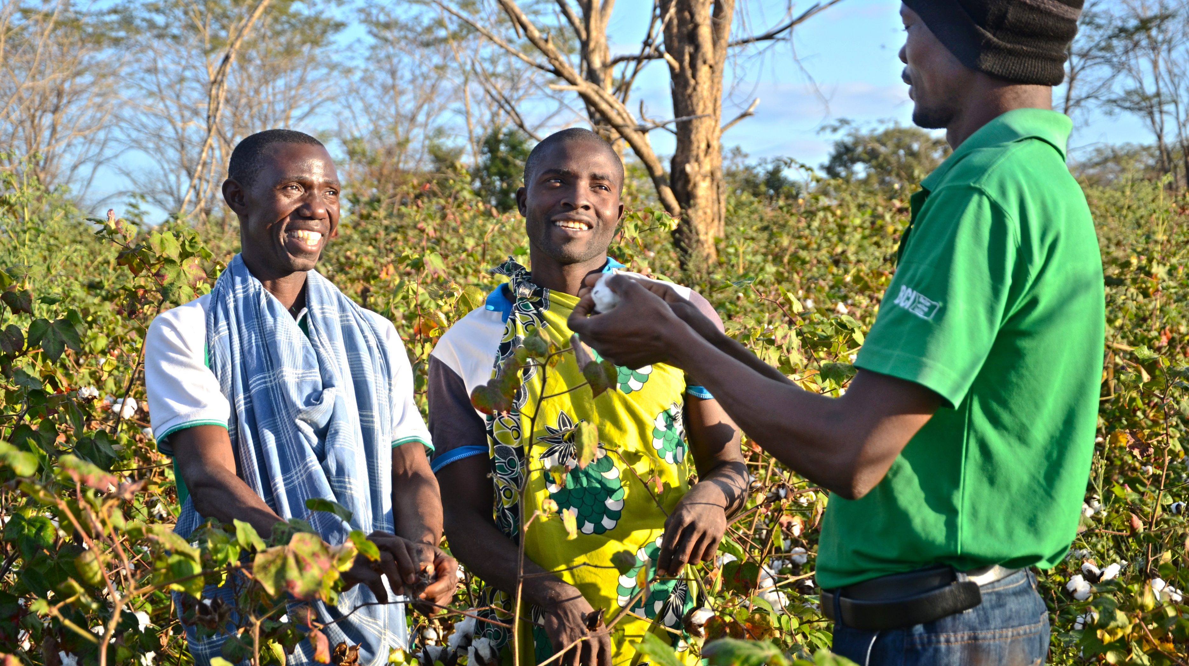
Notes:
Mozambique

Slide 15
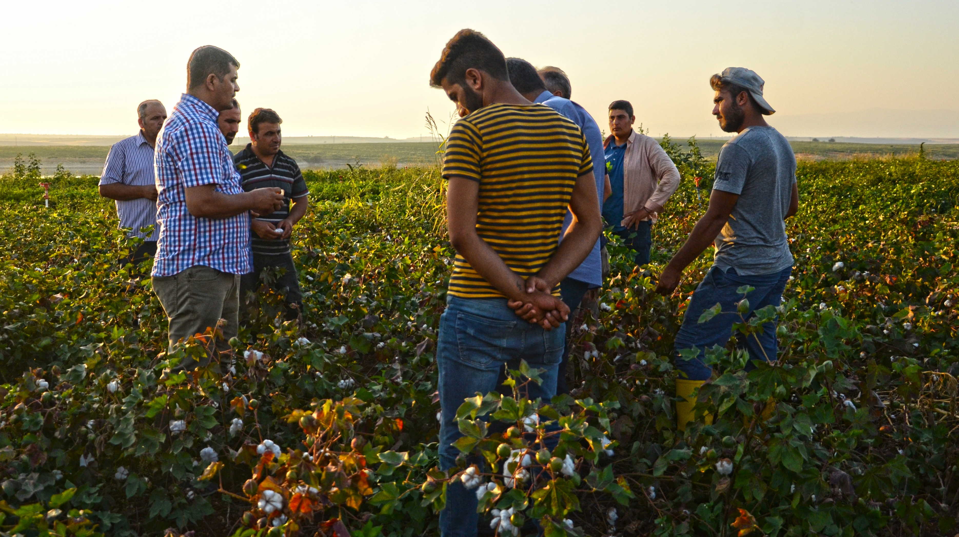
Notes:
Turkey

Slide 16





Member Meeting
Wednesday 21 June: 09:00 – 10:00
With
Claire Doole | Conference Host

Slide 17

Welcome
Marc Lewkowitz
President and CEO, Supima
Better Cotton Council Chair

Slide 18
Year in Review v6
Length: 02:20

Slide 19
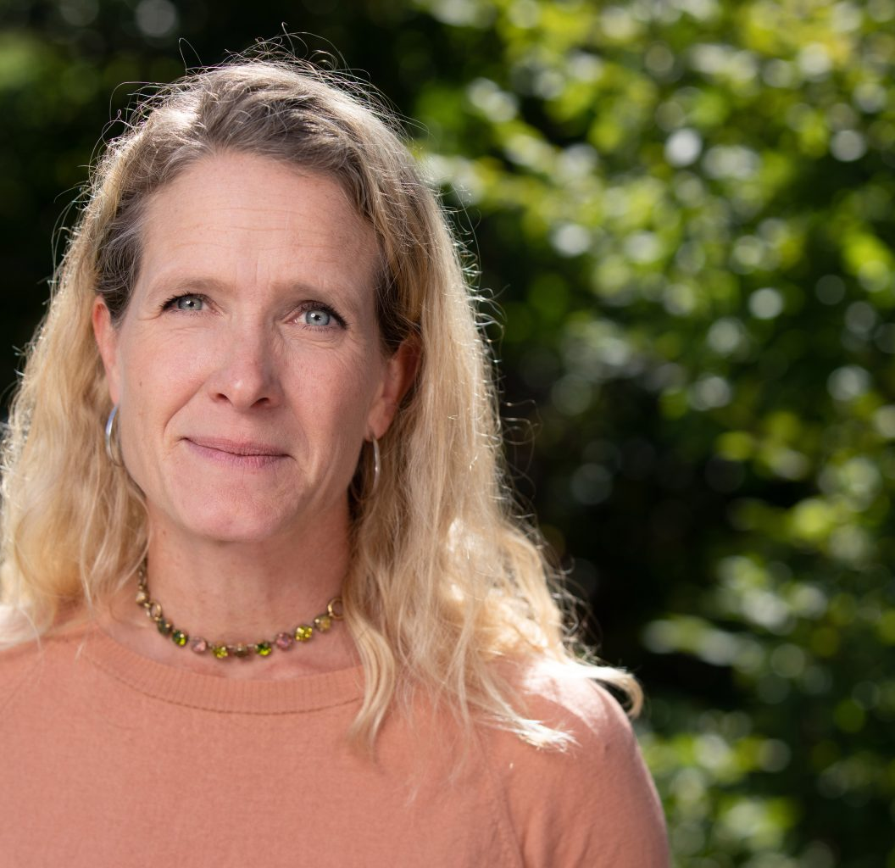
Principles and Criteria
With:
Lena Staafgård
COO, Better Cotton

Slide 20
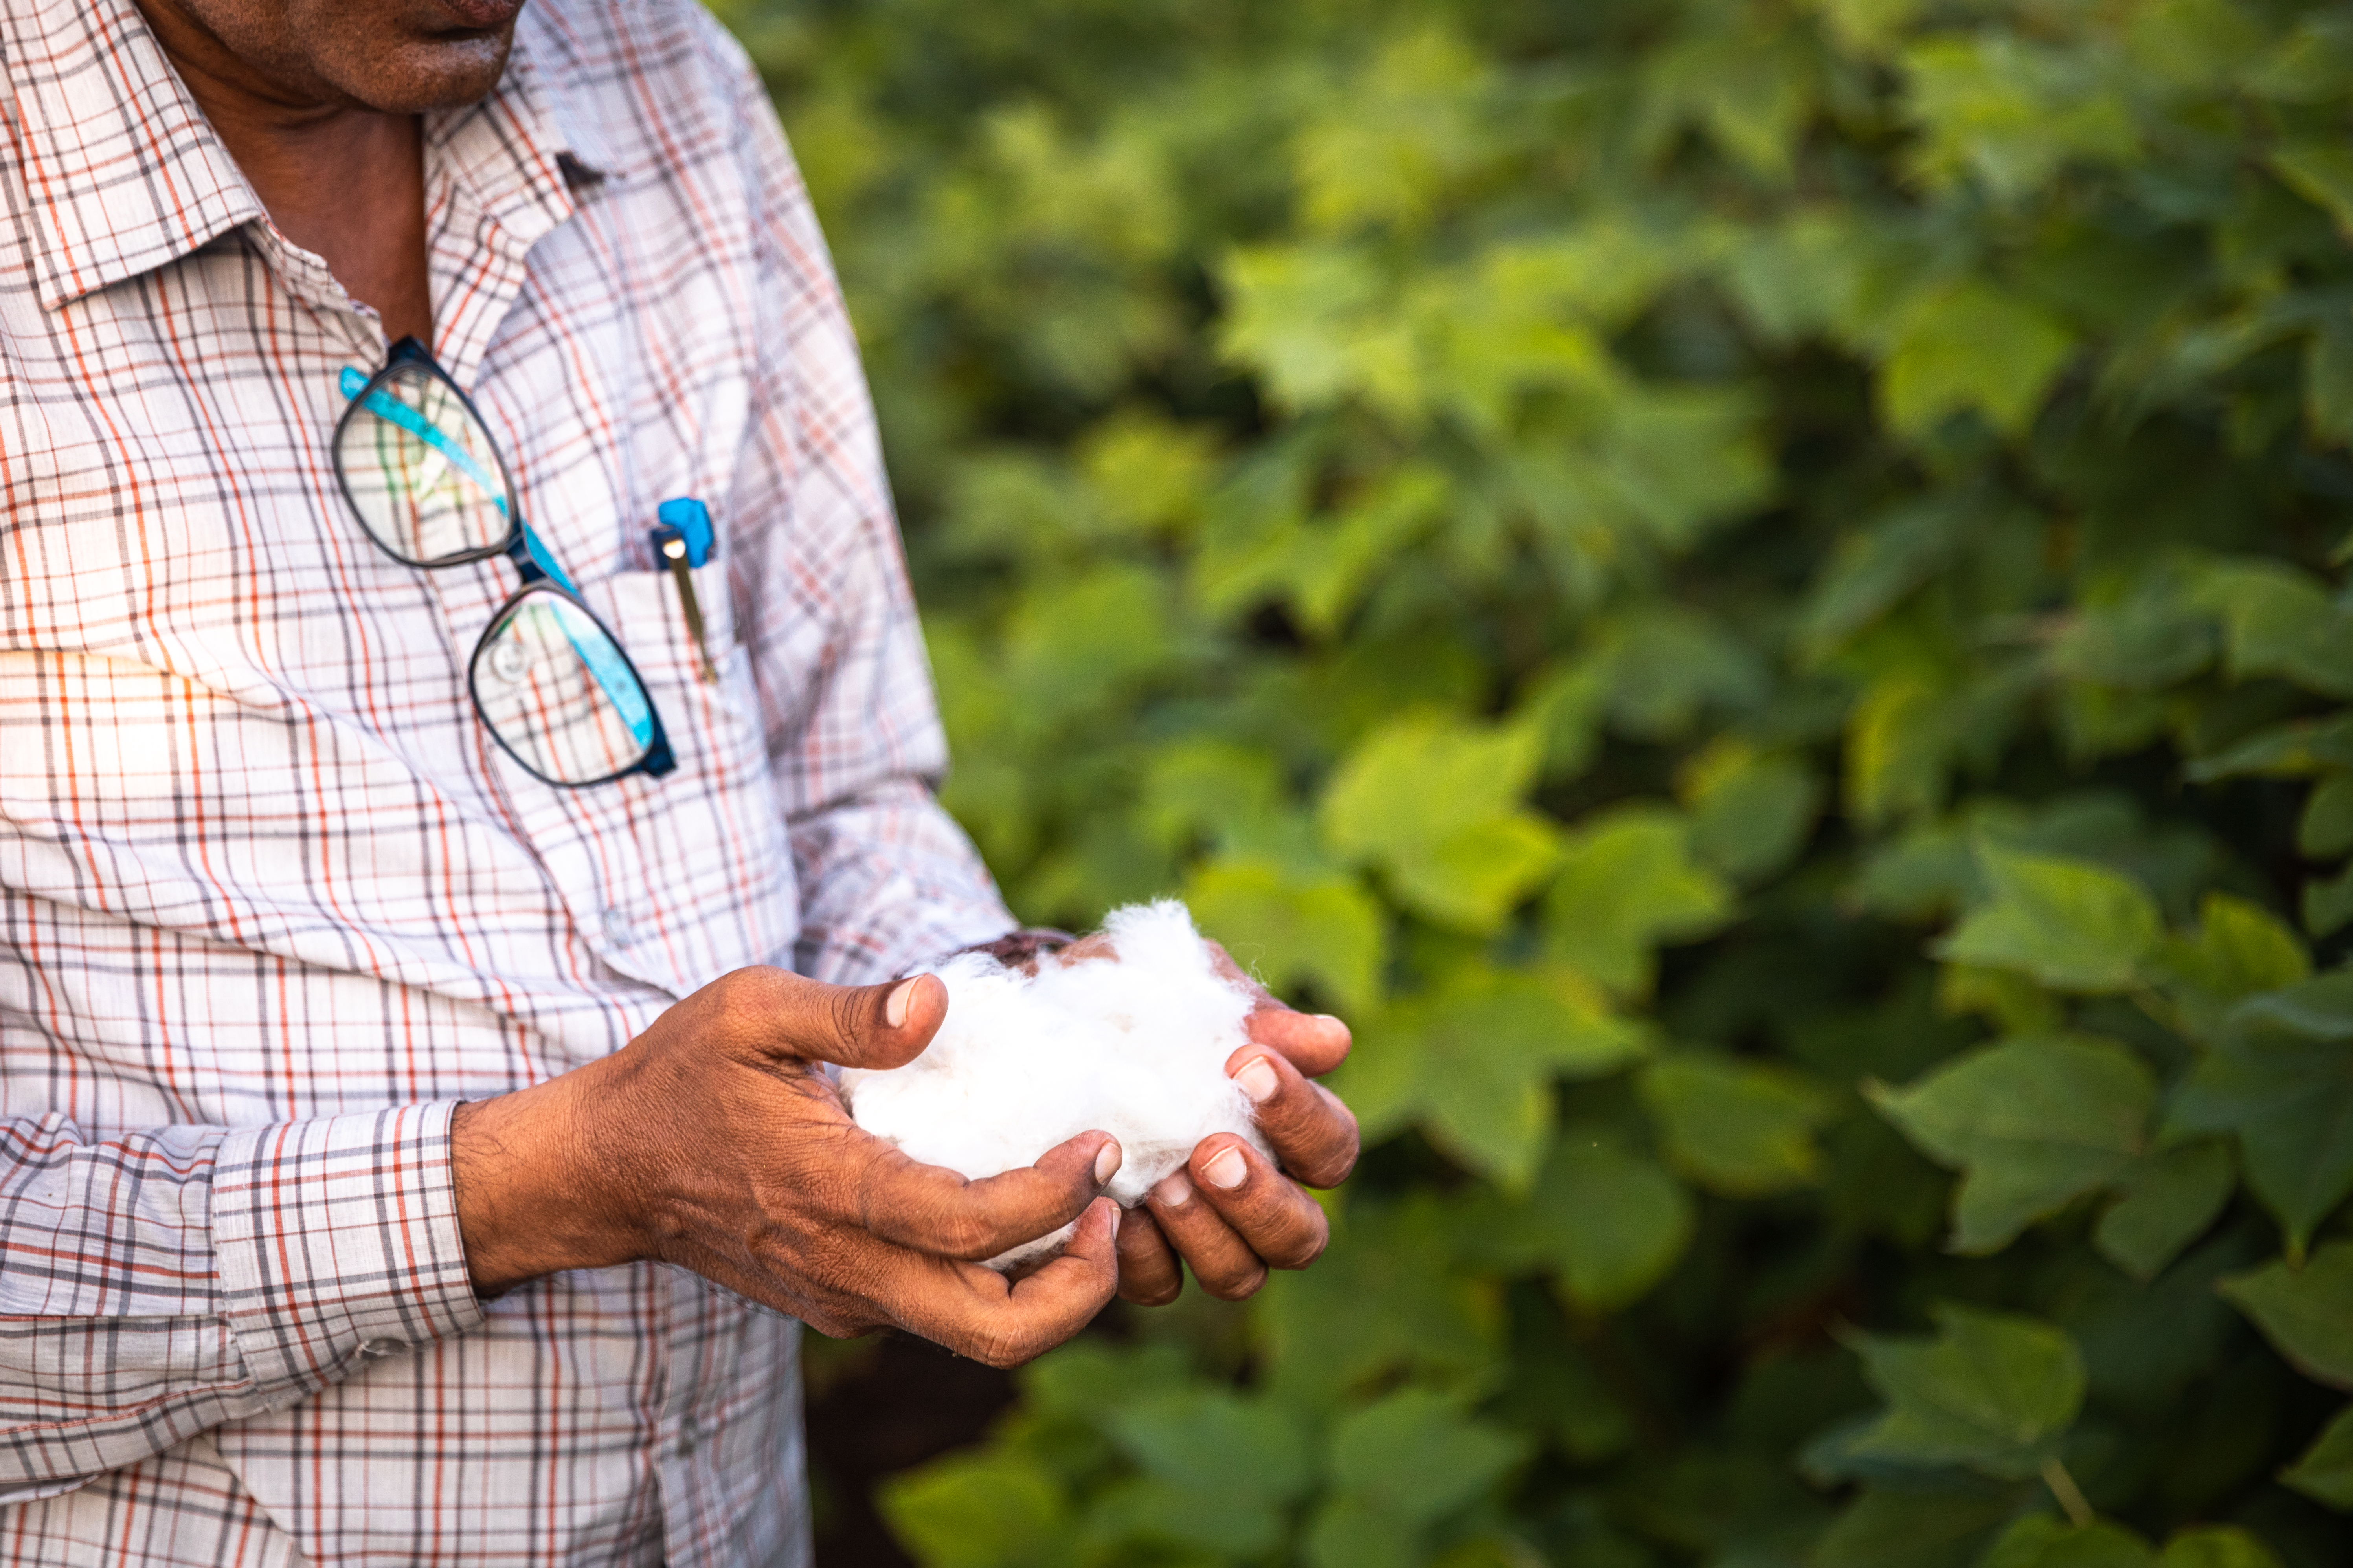


Slide 21

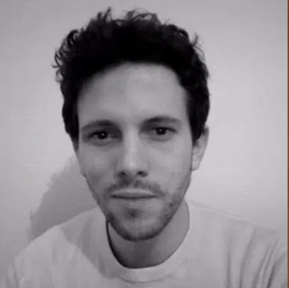
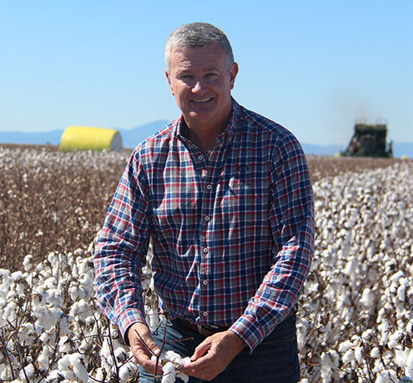
Climate Action
With:
Nathanael Dominici
Climate Change Manager,
Better Cotton
Adam Kay
CEO, Cotton Australia

Slide 23
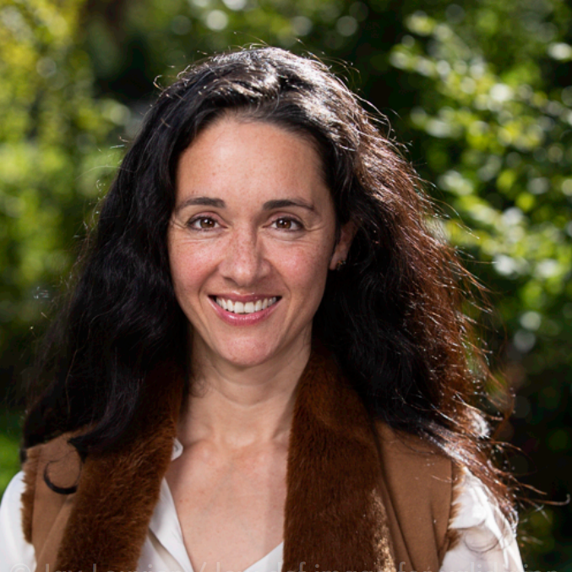
Traceability & Data
With:
Alia Malik
Senior Director, Data & Traceability,
Better Cotton

Slide 25
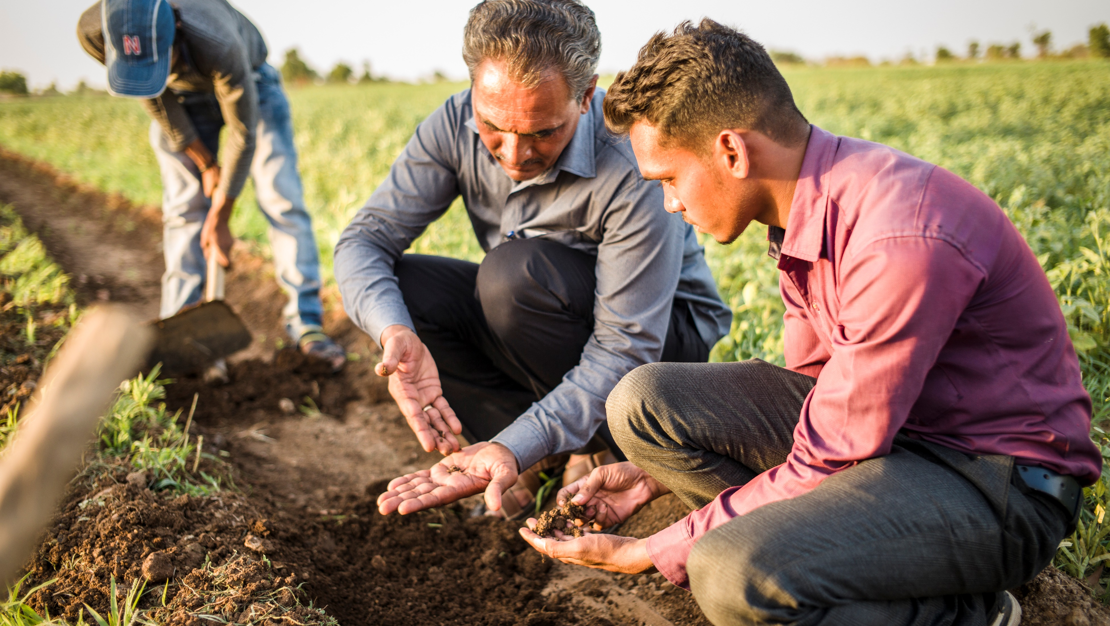
India Impact Report
June 2023
Notes:
For the last 18 months, we have been working on our approach to monitoring and reporting results.
Previously we reported on the results of Better Cotton Farmers in on specific indicators in comparison to those of similar, non-participating farmers.
We now have an improved external reporting model that will deliver greater insights and transparency to our programme -reporting on the performance of Better Cotton Farmers over a multi-year timeframe.
This is important, as measuring results trends over time is especially relevant in the context of agriculture because of the many factors — that can skew a single season’s results — some beyond farmers’ control like changing rain patterns, floods, or extreme pest pressure.
So, this summer, Better Cotton is set to release its first report using this model – looking at Better Cotton’s programme in India,
Now I’m excited to share with you a sneak peek of the report’s findings on pesticides:

Slide 26
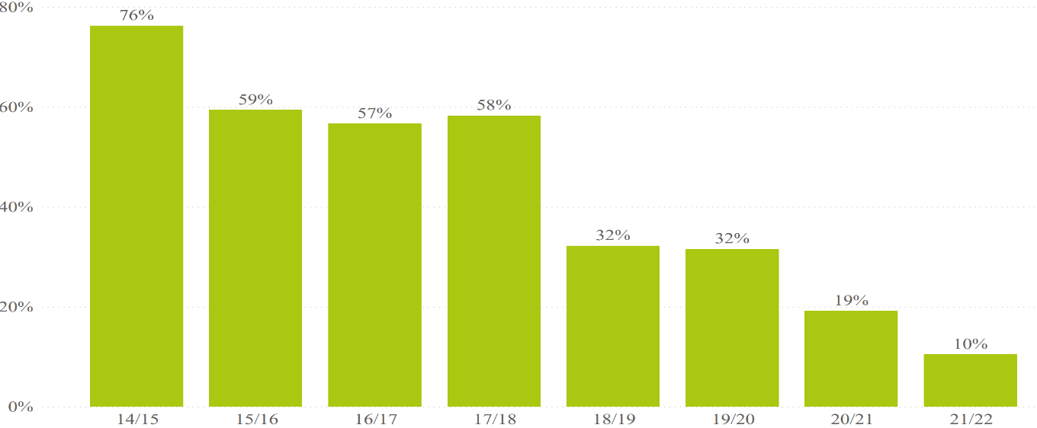
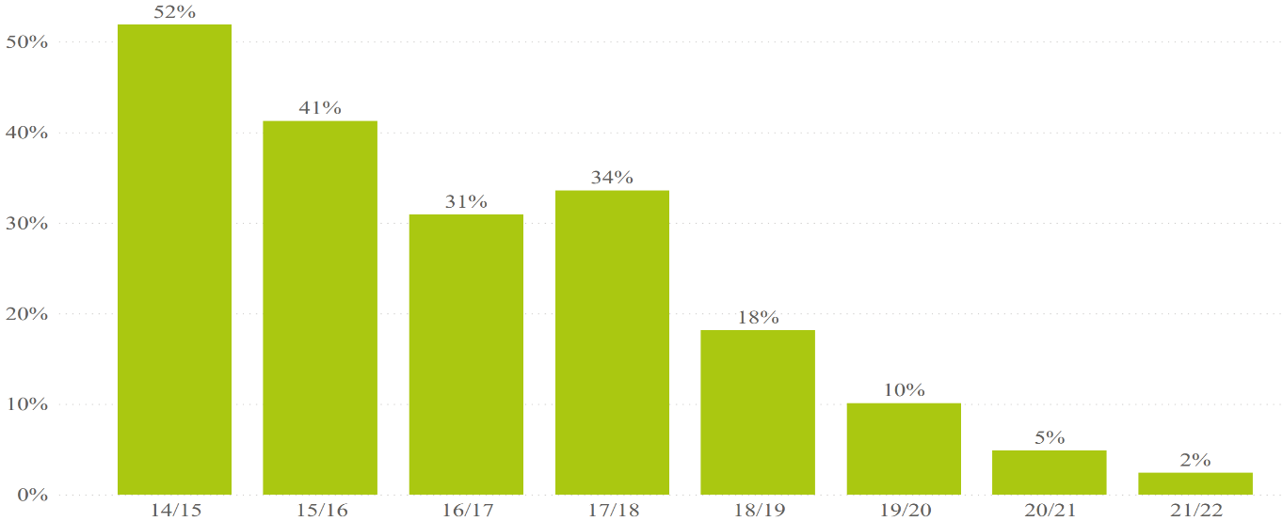
Pesticides and Highly Hazardous Pesticides
Use of Highly Hazardous Pesticides dropped from
Use of Monocrotophos
dropped from
76% to 10%*
52% to 2%*
Percentage of India Better Cotton Farmers Reporting the Use of HHPs
Percentage of India Better Cotton Farmers Reporting the Use of Monocrotophos
Percentage of Farmers
Percentage of Farmers
Season
Season
* Between the 2014-15 and 2021-22 seasons
Notes:
Cotton farmers across India struggle with pests (particularly the pink bollworm, which has plagued cotton-growing areas in recent years.)
Farmers often lack knowledge of effective practices, leading to widespread use of synthetic pesticides and harmful chemicals
Key Findings

Slide 27
Pesticides and Highly Hazardous Pesticides
 | Variation from avg. 3 seasons 2014-2017
Permitted | -38%
Carcinogen, Mutagen, reprotoxic | -76%
Highly toxic | -98%
Extremely toxic | -99%
Pending approval as PiCs | -85%
PiCs, PoPs, Montreal | -97%
Total | -53%
Quantity used of active ingredients dropped by
53%*
* Between the 3 seasons average (2014-15, 2015-16 and 2016-17) to 2021-22 season.
Notes:
Total reported use of active ingredients for crop protection (insecticides, herbicides, fungicides etc) among Better Cotton Farmers dropped by around 53% between the 3 seasons average (2014-15, 2015-16 and 2016-17) to the 2021-22 season.

Slide 28
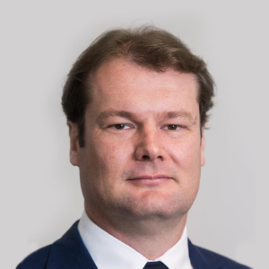
Traceability & Data
With:
Alexandre Schenkle
President, ABRAPA

Slide 30
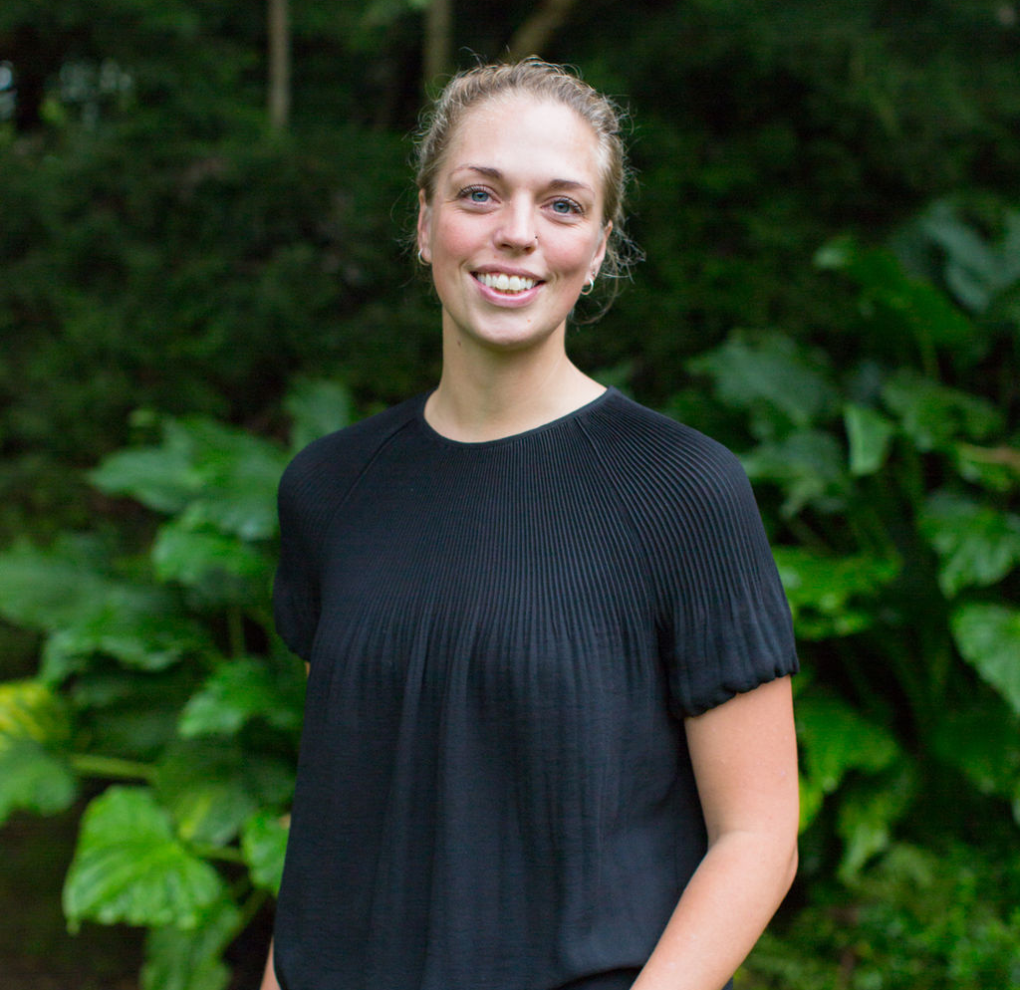
Sustainable Livelihoods
With:
Maria Kjaer
Smallholder Livelihoods Manager, Better Cotton

Slide 32
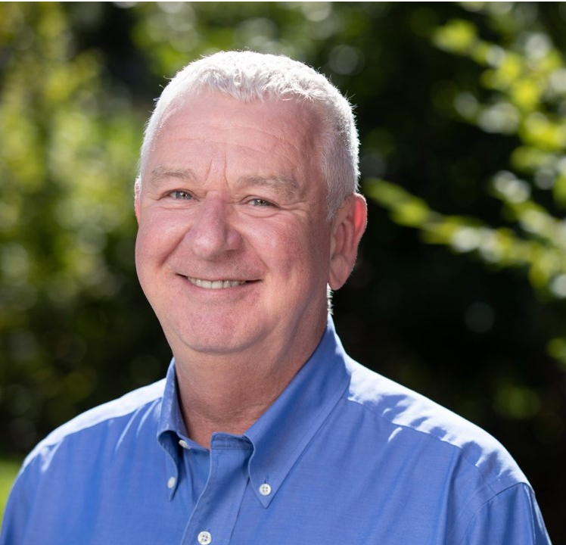
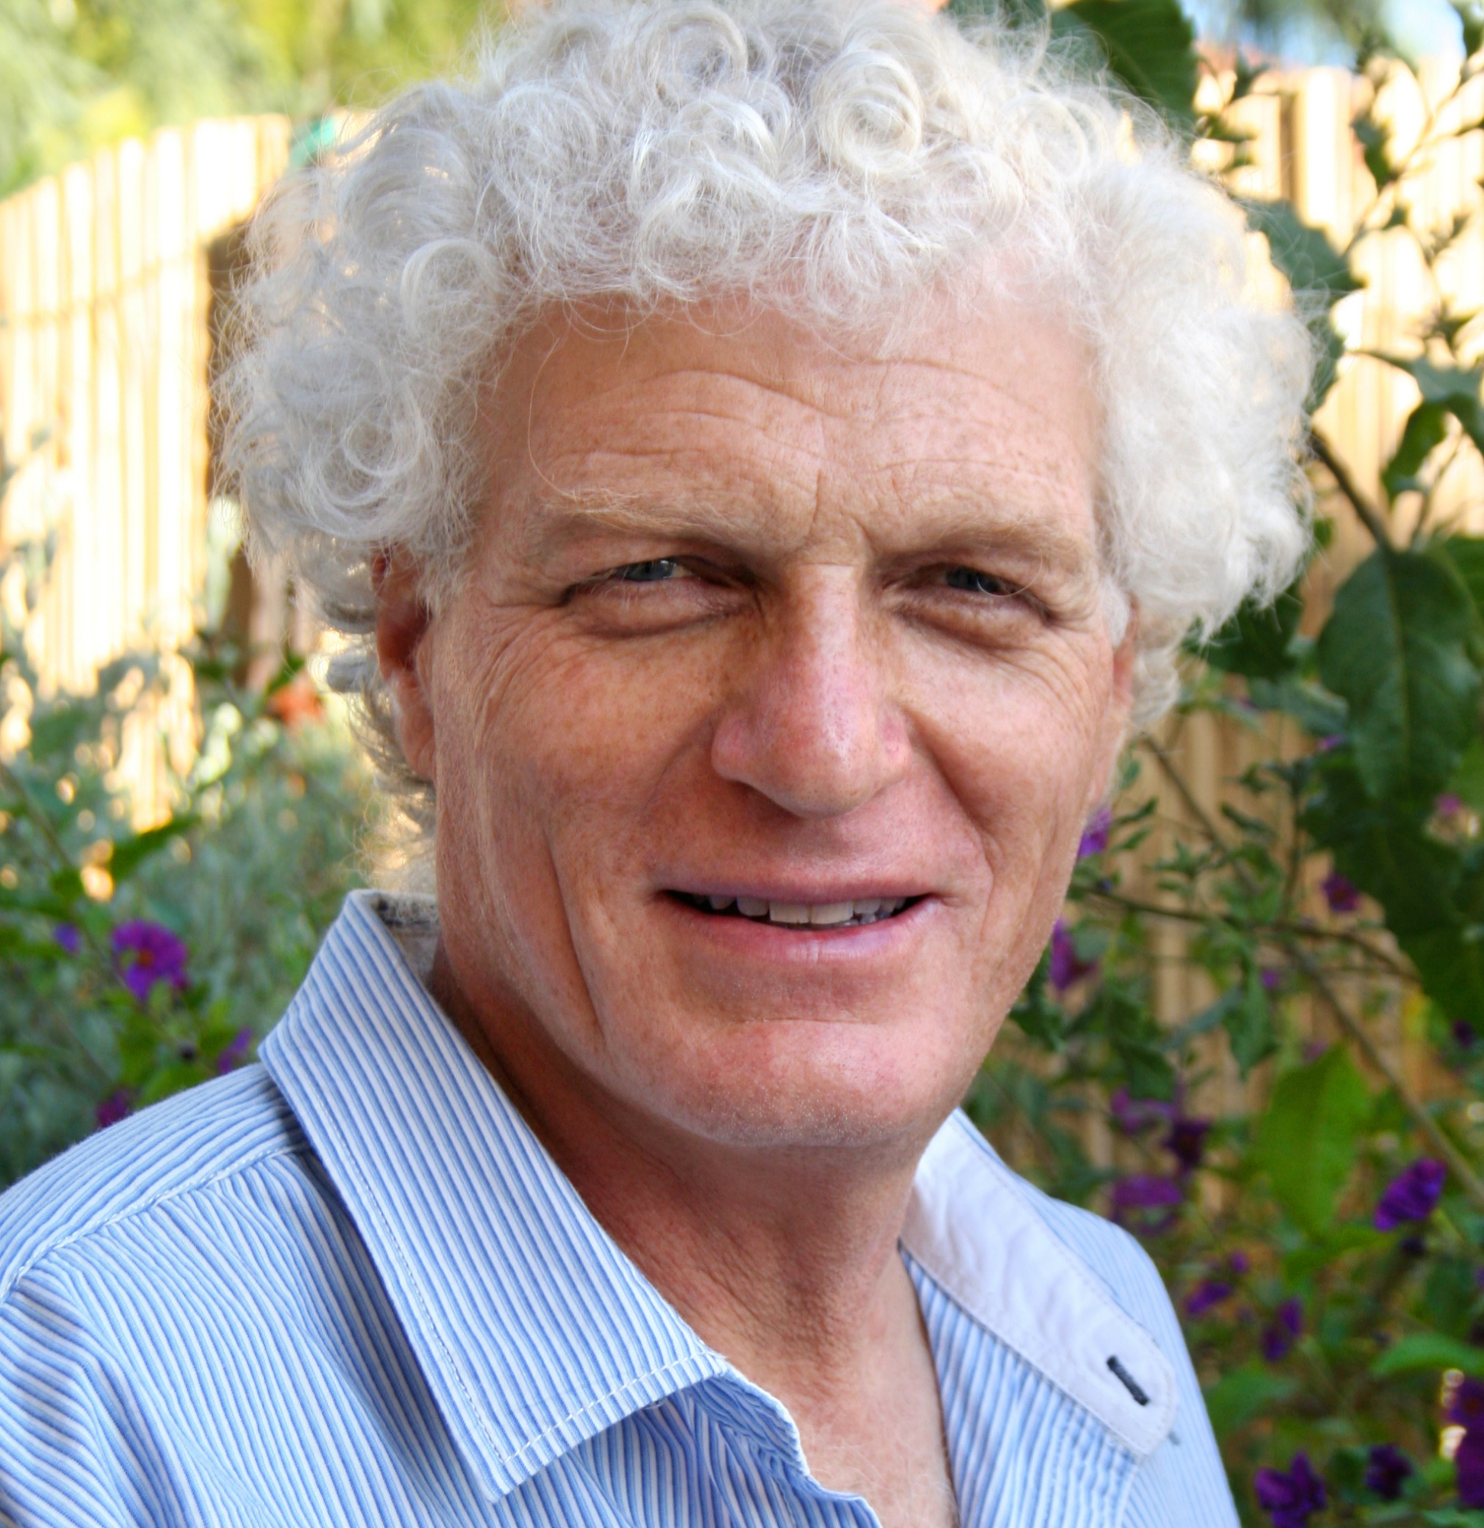
Regenerative Agriculture
With:
Alan McClay
CEO, Better Cotton
Jonathan Spenser
Project Officer, Israel Cotton Board

Slide 33
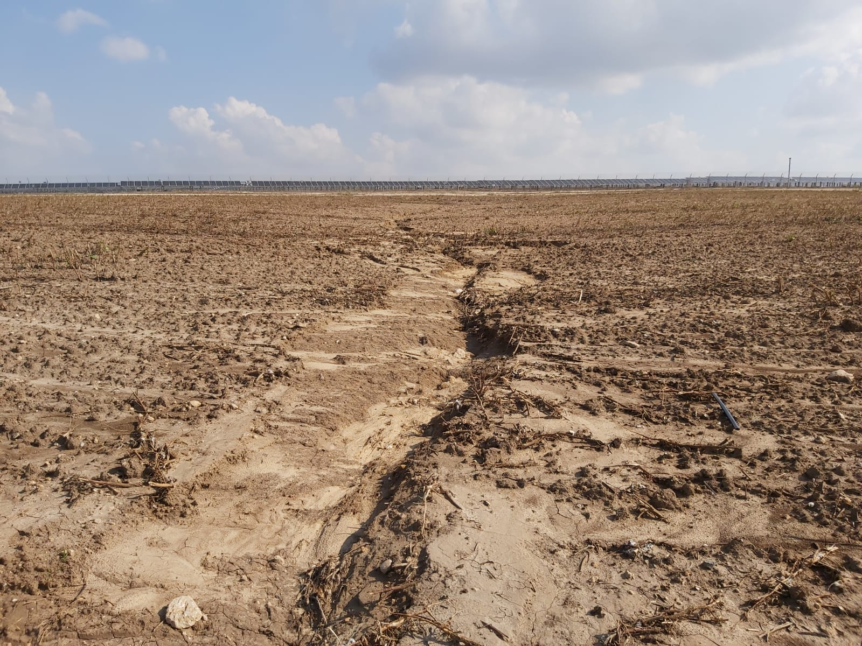

Slide 35
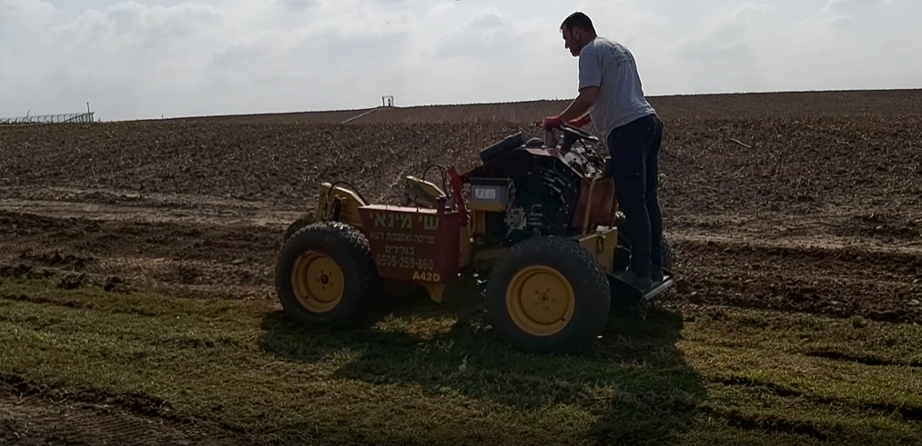

Slide 36
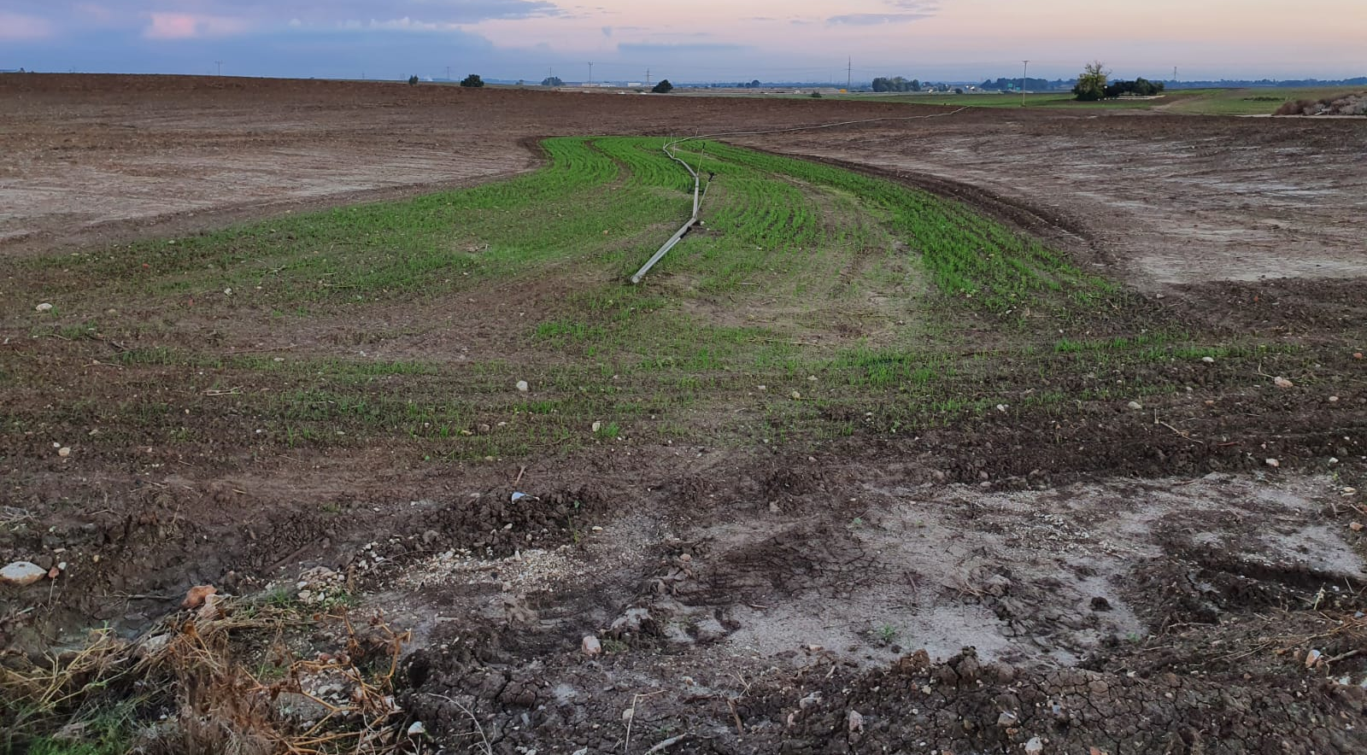

Slide 37
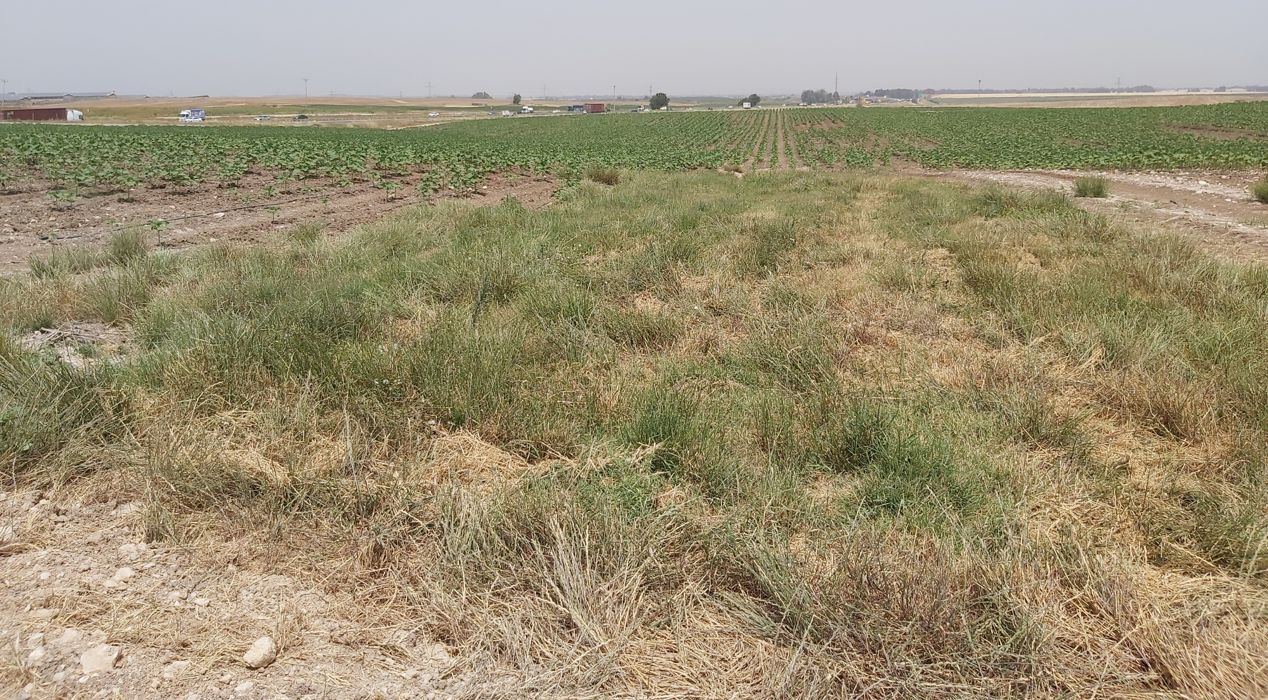

Slide 38
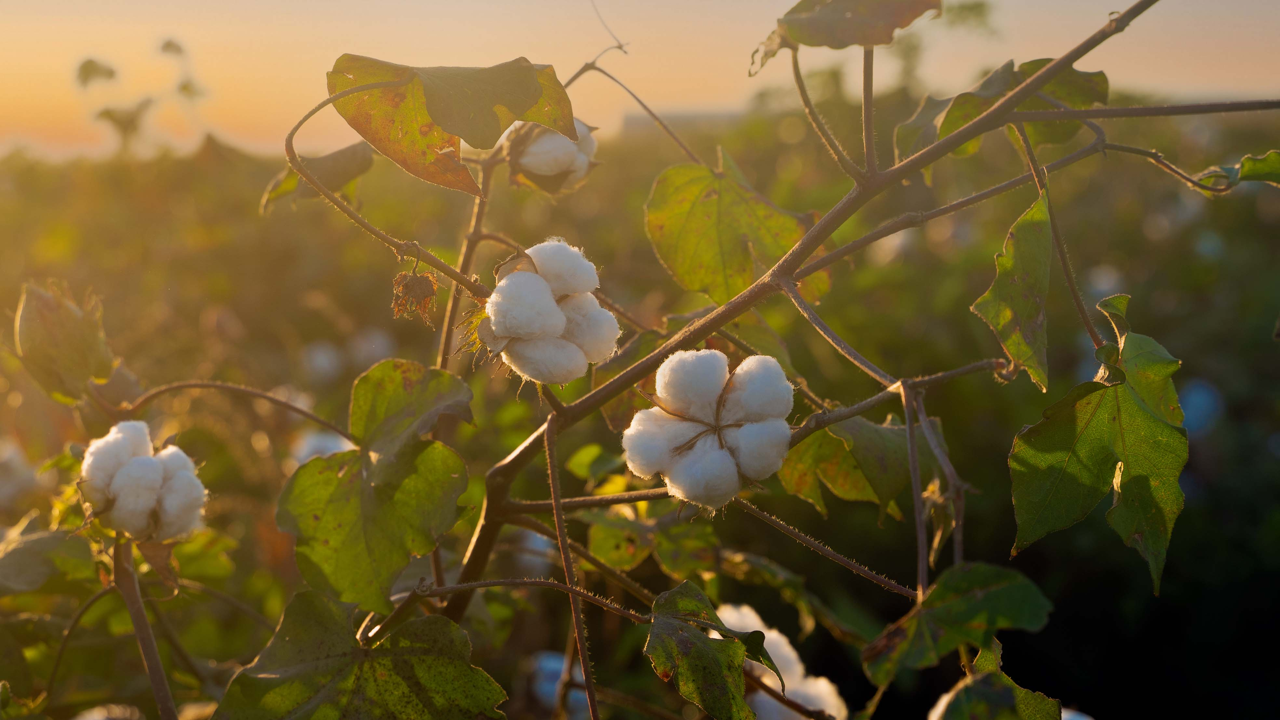
  Thank you

Slide 39
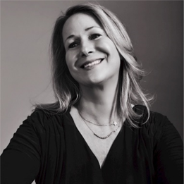
Regenerative Agriculture
Liz Hershfield
Head of Sustainability, J. Crew

