Slide 1
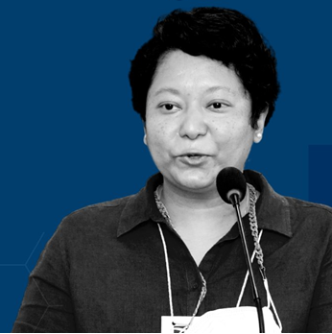
Climate Action:
Keynote Opener
Wednesday 21 June
Inclusive Climate Action: Moving Beyond Commitments to Actions & Impact Measurements
With Nisha Onta | Regional Coordinator for Asia, WOCAN

Slide 2
Inclusive Climate Action: Moving Beyond Commitments to Action & Impact Measurements Nisha Onta, PhD

Slide 3
No growing region will be unaffected
Impacts will affect every element of the cotton value chain
Urgent coordinated & interlinked action on adaptation is needed with climate justice and equity at the core to build sector’s resilience

Slide 4
Scientists warn that human-induced climate change is warming the planet to the point where it is causing irreversible damage in some parts of the world.

Slide 5
Better Cotton’s 2030 Strategy & Impact Targets
Better Cotton have launched five Impact Targets that underpin our 2030 Strategy and will help drive environmental and social change at field-level.
By 2030, sustainably increase the net income and resilience of two million cotton farmers and workers.
Reduce the use and risk of synthetic pesticides applied by Better Cotton farmers and workers by at least 50%.
Ensure 100% of Better Cotton farmers have improved the health of their soil.
Reach 1million women in cotton with programmes and resources that promote equal farm decision-making, build climate resilience, or support improved livelihoods.
Ensure 25% of field staff are women with the power to influence sustainable cotton production.
Reduce greenhouse gas emissions by 50% per tonne of Better Cotton lint produced by the end of the decade.

Slide 6
We need to do MORE
Let’s be bolder
and
overhaul our actions

Slide 7
Farmers at the Center

Slide 8
Data as the key for change
System Change
Unconventional collaborations

Slide 9
What gets Measured gets Valued

Slide 10
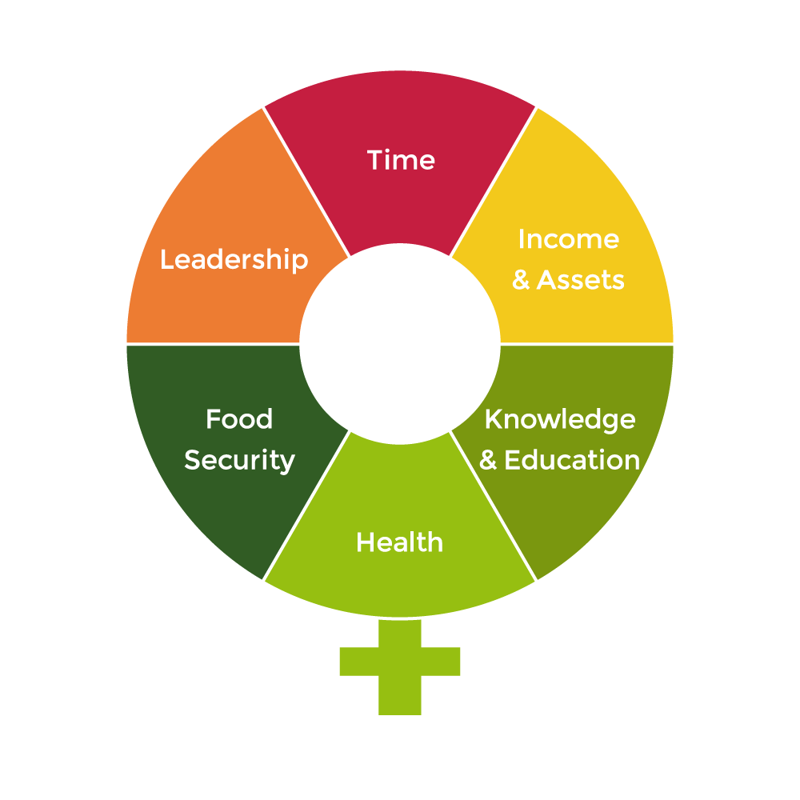
The W+ Standard
What it is:
Standard/certification framework that provides metrics and procedures to quantify, verify and monetize women’s empowerment results within projects and supply chains.
Endorsed by the IRIS+, Verra and others.
Momentum for Change Award 2016

Slide 11
Bold Actions
Measure Impact
Gender Equality
Notes:
15 to date

Slide 12
Nisha Onta, PhD Regional Coordinator for Asia
nishaonta@wocan.org

