Slide 1
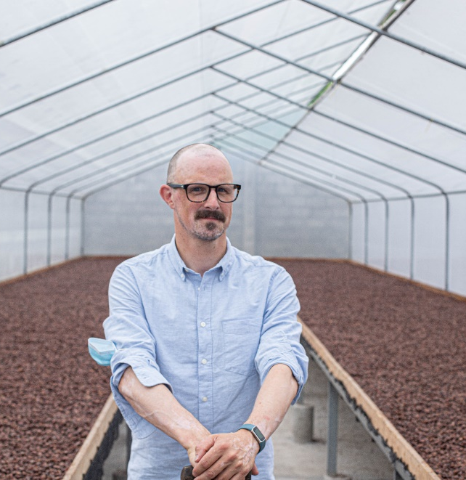
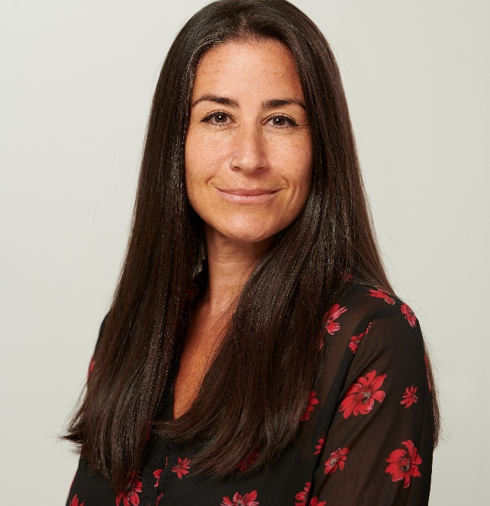
Deconstructing living income
Plenary
Wednesday 21 June
With Speakers:
Antonie Fountain Managing Director, VOICE Network
Ashlee Tuttleman Senior Innovation Manager, Smallholder Sourcing and Services

Slide 2
Better income means being able to earn…
...more income for women and men to be able to alleviate poverty towards and beyond a living income.
... a stable income to be resilient against shocks and other risks throughout and over the years.
...an equitable income, to ensure that men, women and youth have equal chances on a better income while not harming the environment, local communities and generations to come.
With this in mind, we target:
Farmers and/or farming households (women and men) – mostly smallholder - that are ultimately responsible for the farm. This means they bare all costs and risk related to the farming operations and expect to earn from the fruits of their labour.

Slide 3
How much is “more” income?
Prosperous income
Living Income Costs of a decent standard of living
National poverty line
SDG1: Elimination of extreme poverty

Slide 4
Living Income
Potential Household Income
Cost of a basic, decent standard of living for a household
Living Income Benchmark
Living Income Gap
Food for model diet
Decent Housing
Off Farm Income
Other Farm Income
Other essential items
Net Household Income
Focus Crop Income
Unexpected Events
Adapted from Living Income Community of Practice

