Slide 1
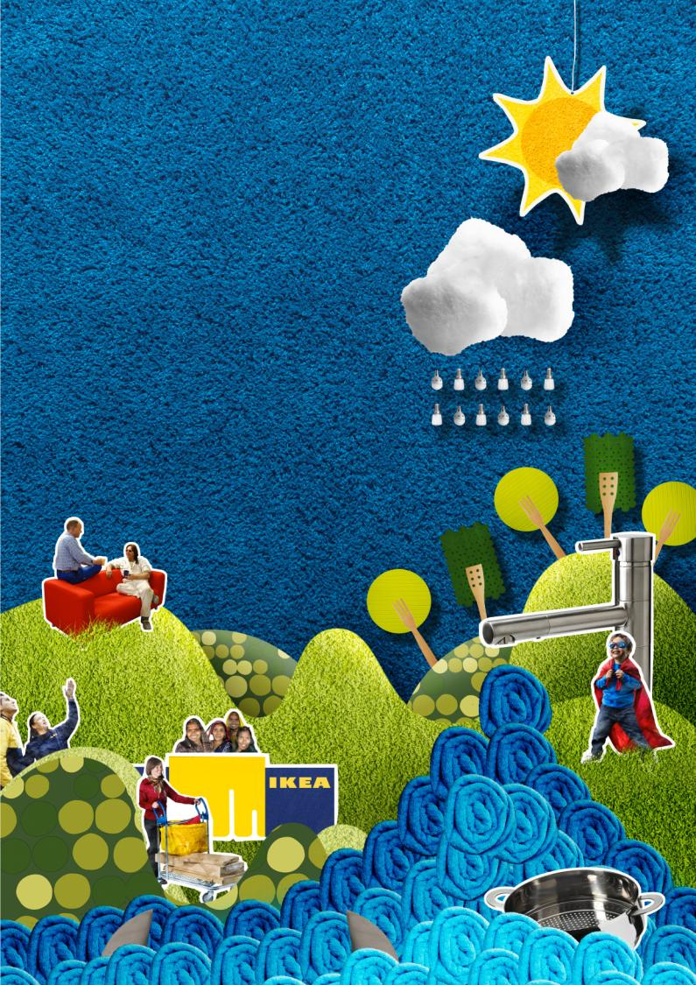

PEOPLE &
PLANET
POSITIVE
IKEA Sustainability Strategy
19th August 2014
Shanghai
Helen Fu
Deputy Sustainability Manager

Slide 2
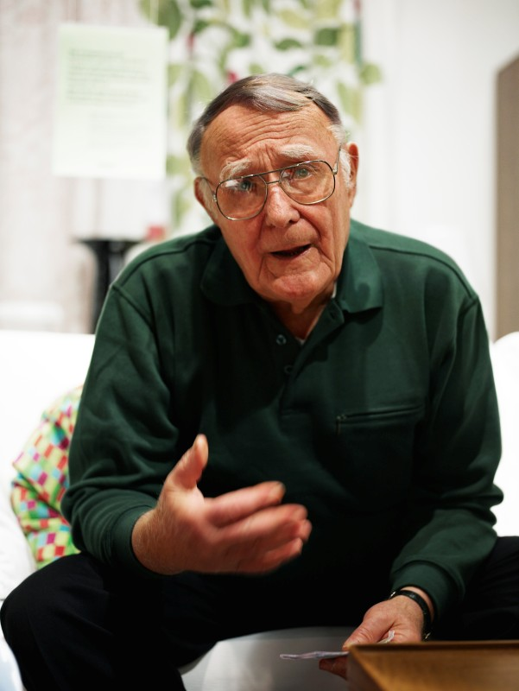
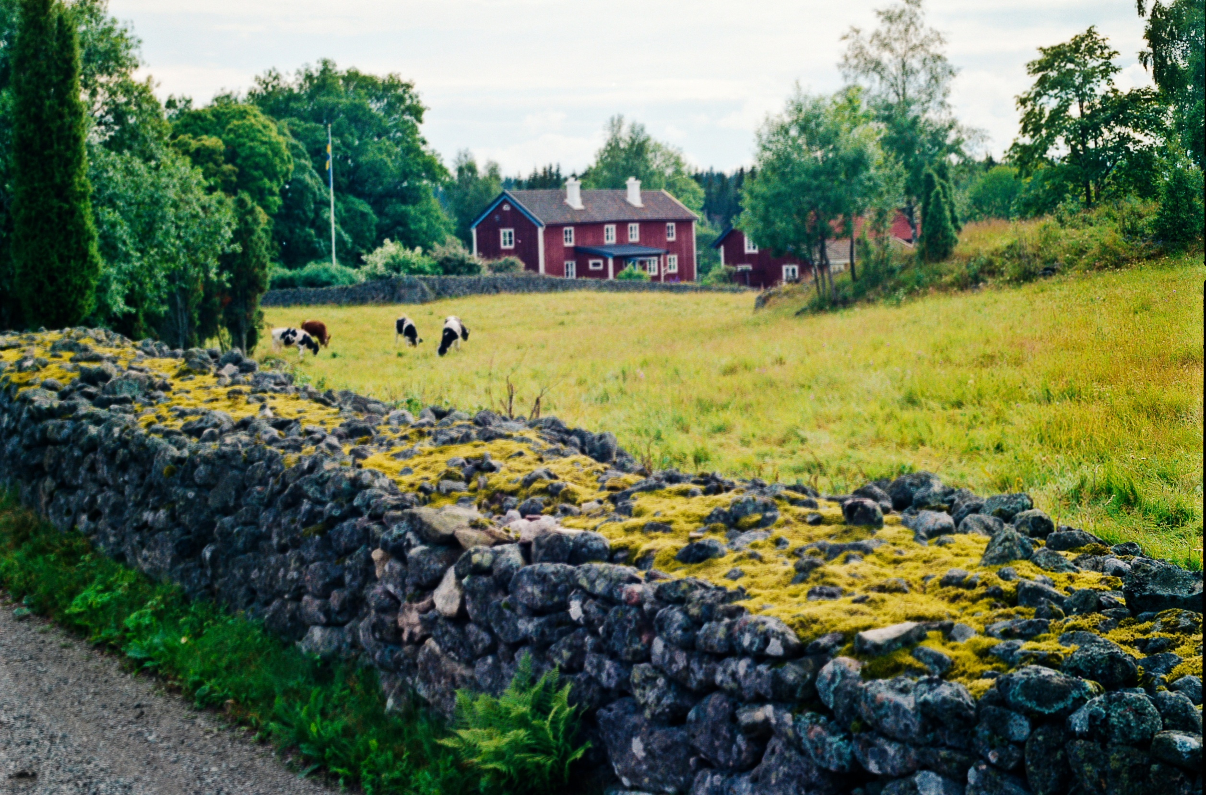
Where we come from
The IKEA Concept was born in southern Sweden, in the barren landscape of Småland.
The stone wall is a symbol of IKEA, presenting simplicity & hard work.
Ingvar Kamprad

Slide 3

Name of the founder
The farm
The village
Ingvar Kamprad
Elmtaryd
Agunnaryd

Slide 4

IKEA Group at a glance
€1.4 billion
IKEA Food turnover
IKEA Food is comprised of the IKEA Restaurant, IKEA Bistro, IKEA Swedish Food Market and the IKEA co-worker restaurant.
1.3 billion
Visits to IKEA.com
9,500
Products
Every year we launch about 2,000 new products.
212 million
Printed catalogues
The IKEA catalogue app was downloaded 9.7 million times.
IKEA.com visits in billions
135,000
Total co-workers
Total IKEA Group co-workers*
* New way of calculating co-workers
The IKEA Group has adopted a new way of calculating the number of co-workers. Previously published numbers for FY12 and FY13 contained temporary and
seasonal positions.
303
IKEA Group stores
Number of IKEA Group stores

Slide 5
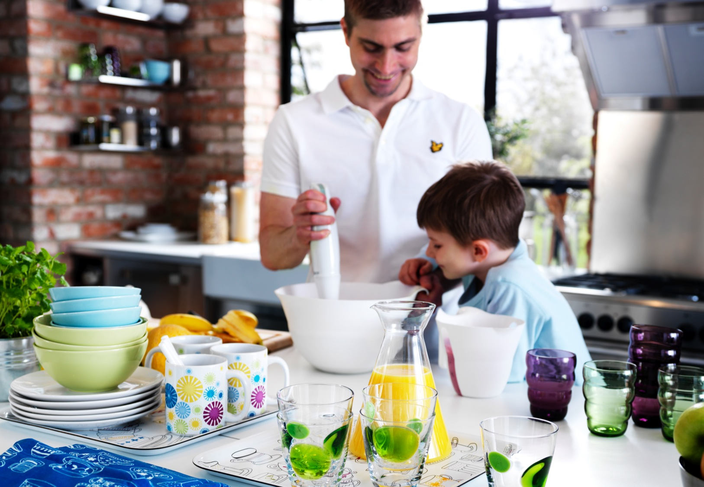

Our vision
To create a better everyday life for the many people

Slide 6
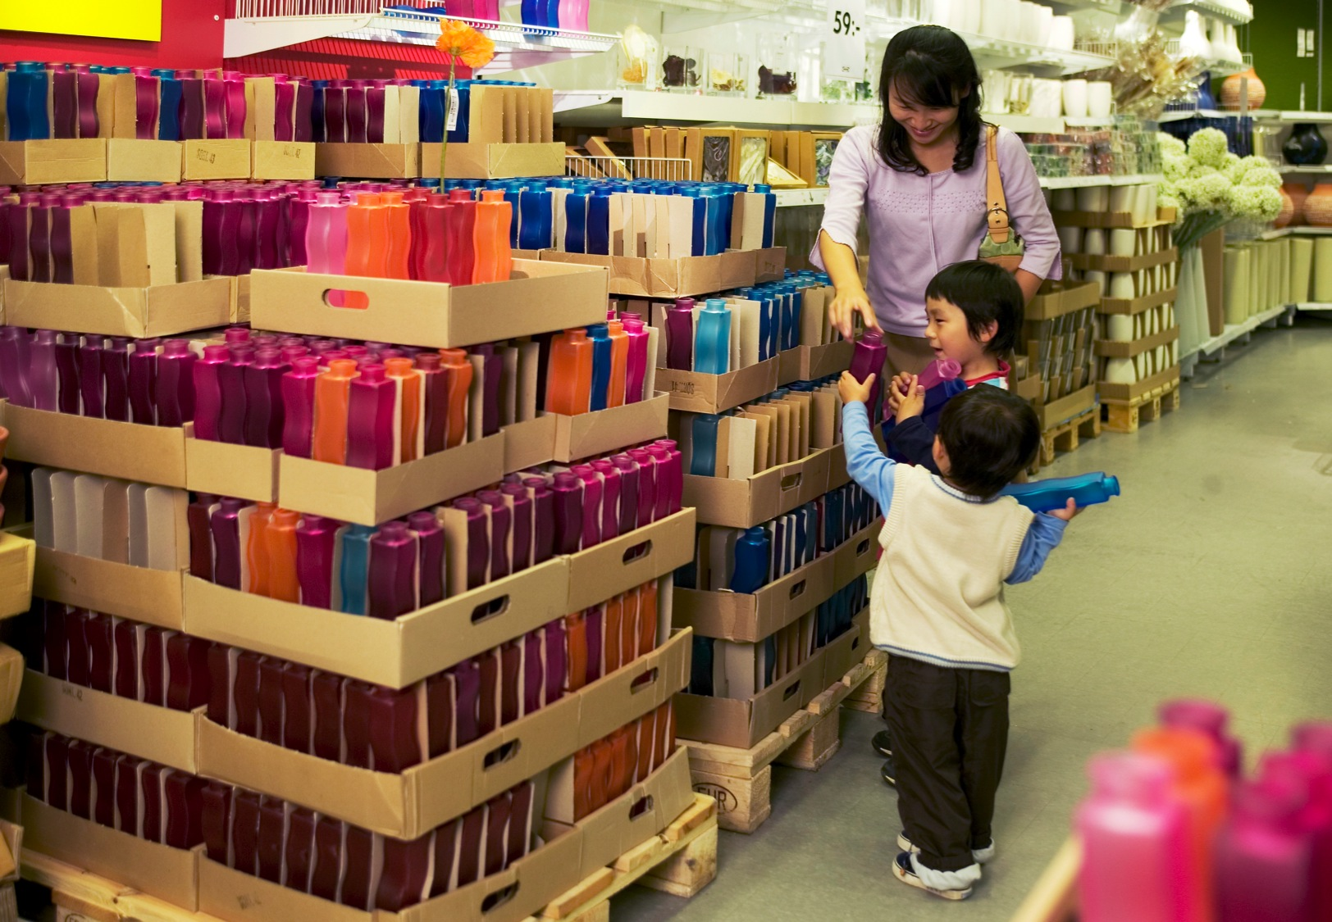

Our business idea
We shall offer a wide range
of well-designed, functional home furnishing products at prices so low that as many people as possible will be
able to afford them.

Slide 7
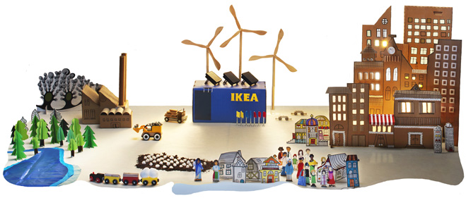
We want to have a positive impact on people and the planet across our value chain.

Slide 8
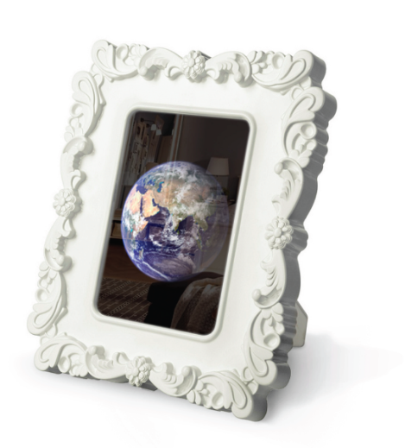
People & Planet
Positive
1
Inspire and enable millions of customers to live a more sustainable life at home
2
Strive for resource and energy independence
3
Take the lead in creating a better life for people and communities
Notes:
Just over a year ago we launched People & Planet Positive . As you know, the strategy contains many ambitous targets:
to enable millions of people to live a more sustainable life at home,
to become resource and energy independent
and to help create a better life for people & communities around the world.
I pleased to say in our first year of working towards these goals, we are making good progress. I will just take a few moments to tell you a bit about what we have achieved across the three focus areas of the strategy globally, and in China.

Slide 9
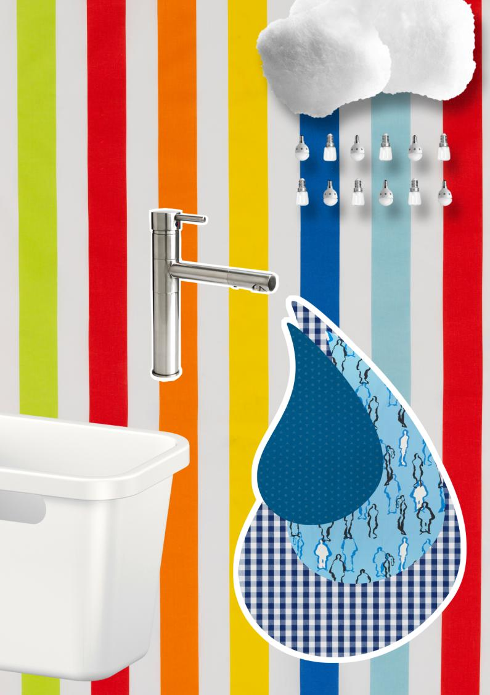
For & together with
our customers
A MORE SUSTAINABLE
LIFE AT HOME

Slide 10
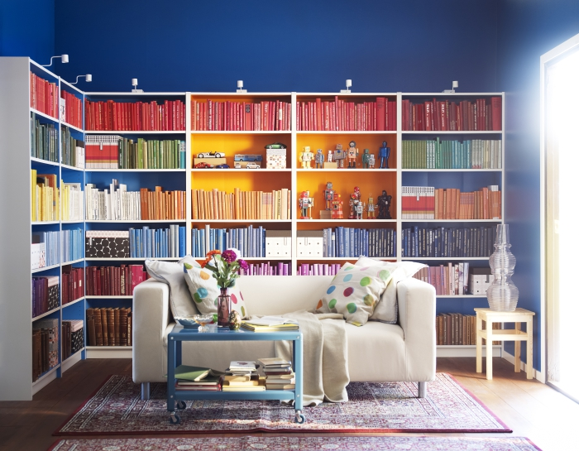
Our goal is to quadruple sales of products that help customers to save and generate energy, and reduce water use and waste at home

Slide 11

Together with
our operations and supplying world
RESOURCE
AND ENERGY INDEPENDENCE

Slide 12


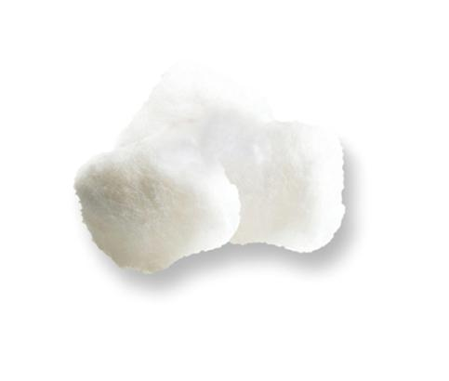
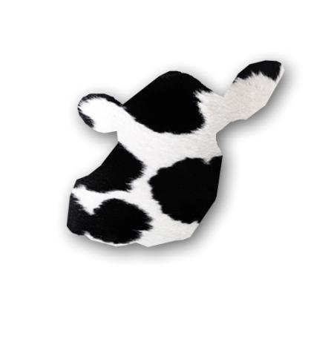
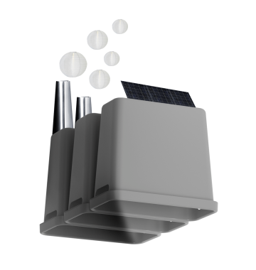
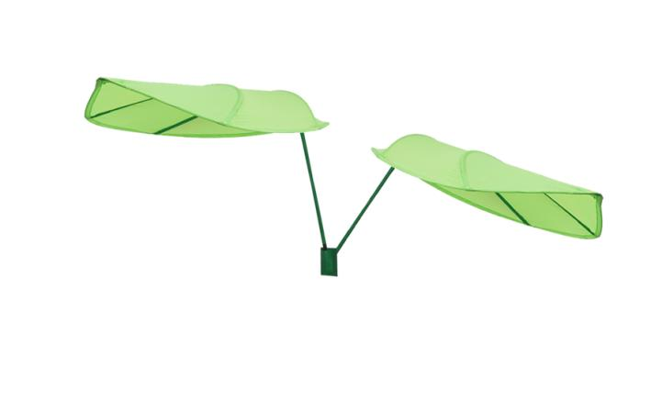
IKEA and the planet
140 million ducks
14 million m³ wood
2 billion m³ water
150,000 tons cotton
1.5 million cows
32 million ton of CO₂ eq.
60,000 ton palm oil
Notes:
Ducks and cows – we use left over material from food industry.
140 million ducks
1.5 million cows (equiv. 7 km2)
13.8 million m3 / X ha of forest (size of Netherlands)
210,000 ton cotton
60,000 tons of palm oil
32 million tons of CO2 – corresponding to the emissions of Cape Town (26.6), Sao Paolo

Slide 13
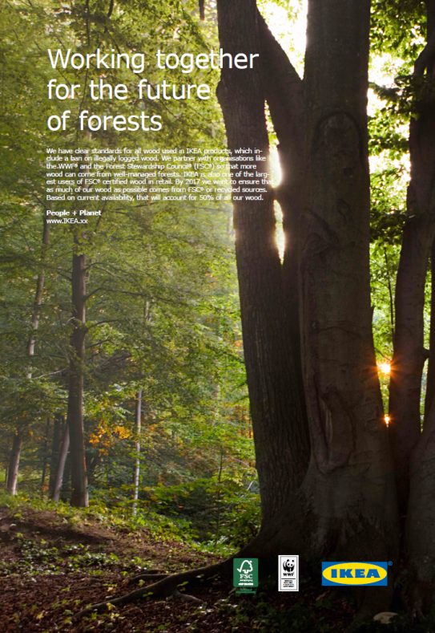
Resource independency
By FY17, 50% of all of the
wood we used will be come
from more sustainable
sources.
In FY13 one third of all of
the wood we used came
from more sustainable
sources.

Slide 14
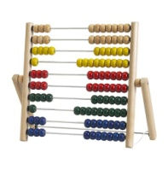
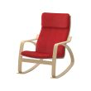
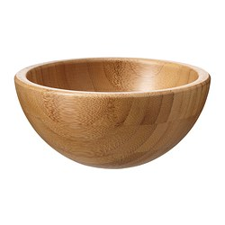
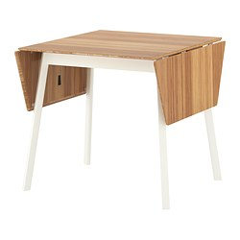
Our products
Solid Wood Products
(100% FSC products)
Bamboo Products
(100% FSC products)
MULA
Toy abacus
POÄNG
Rocking-chair
BLANDA serving bowl
IKEA PS 2012 dining table

Slide 15
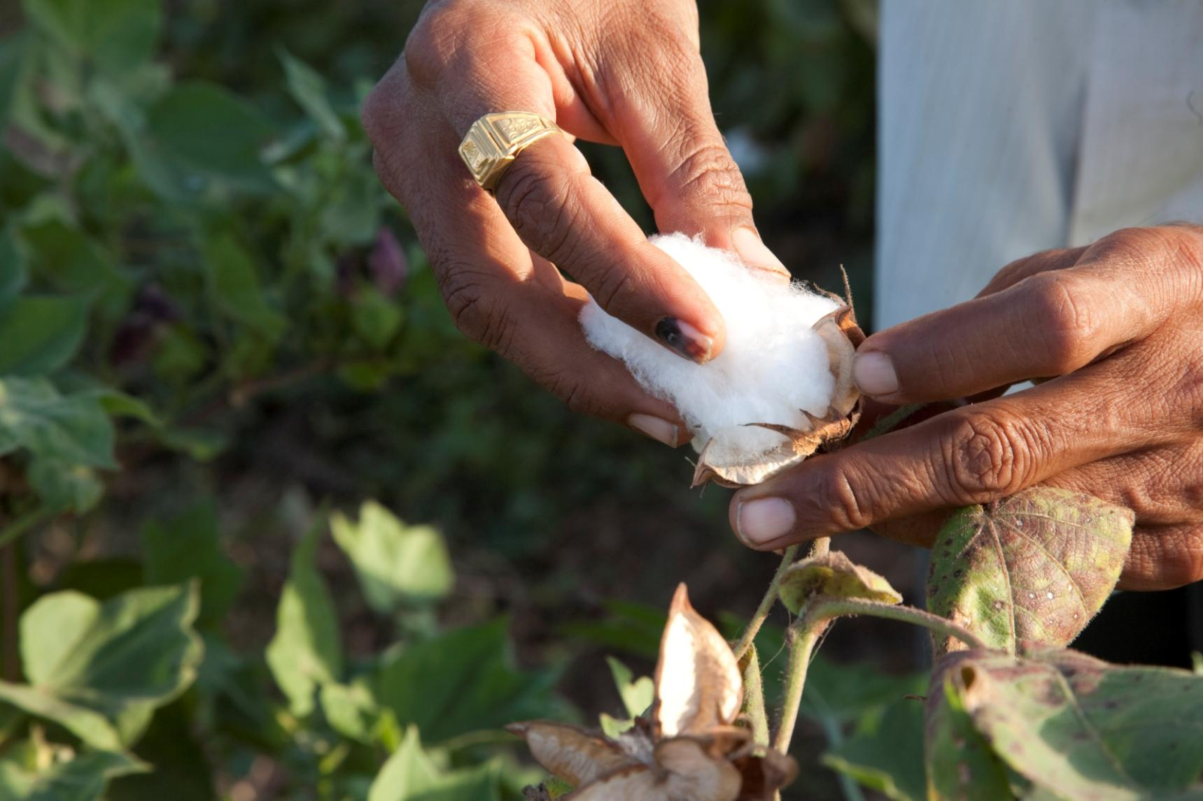
Resource independency
By the August 2015, 100% of IKEA cotton use will be from more sustainable sources.

Slide 16
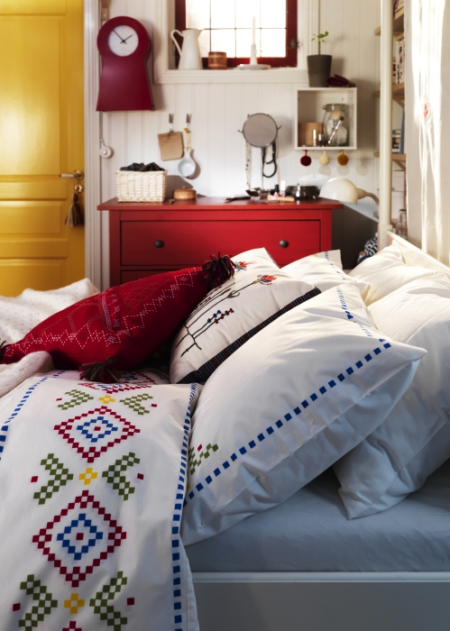
Up to July 2014, 88% of IKEA total cotton used came from sustainable sources.
100% of IKEA Greater China cotton used came from sustainable sources.

Slide 17

By working with global 3rd party audit firm and involving all supply chain stake holders, IKEA secures the cotton traceability from lint cotton to finished products.

Slide 18
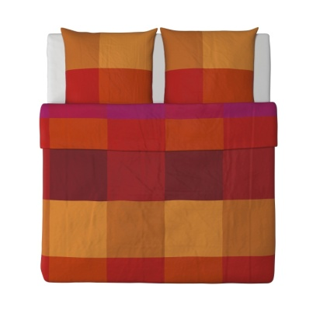
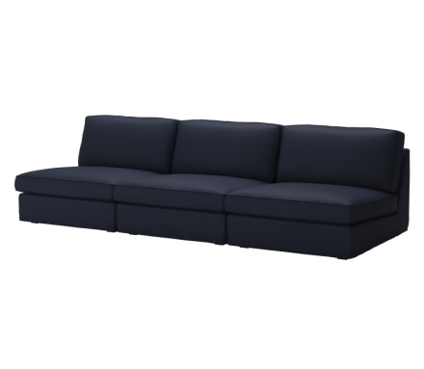
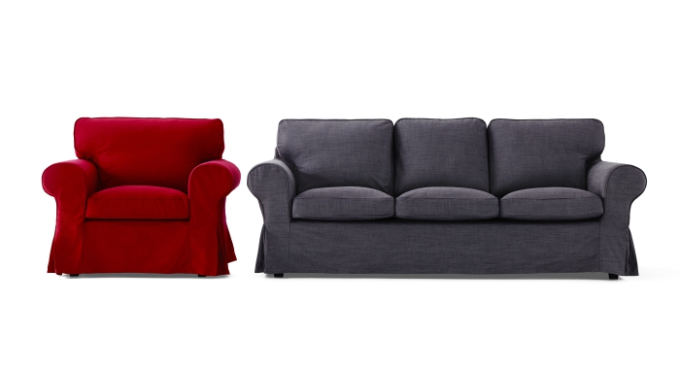
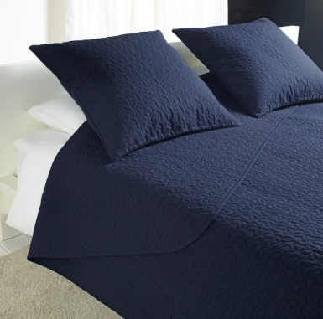

Our products
Textiles Products
(100%Better Cotton)
Sofa Products
(FSC Woods+100%Better Cotton)
BRUNKRISSLA
Bed linen
100% Better Cotton
ALINA
Bedspread
100%Better Cotton, shell fabric
KIVIK
Sofa cover and frame
EKTORP
Sofa cover and frame

Slide 19
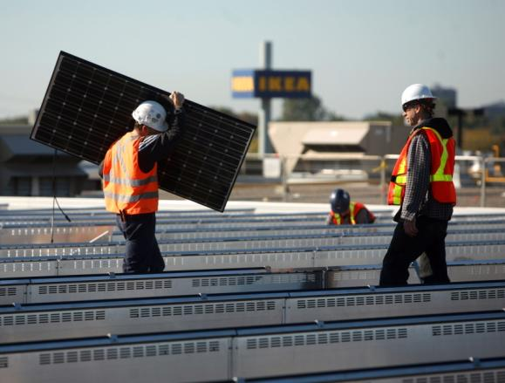
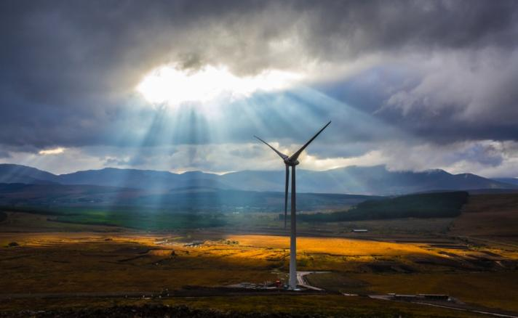
Energy independency
In China we installed 31,000 m3 in 4 stores, generating 1.48 million kWh annually.
The next 3 years investments will contribute with a reduction of CO2 emissions of 6,000 tons/year.
550,000 solar panels
installed worldwide
That’s enough to cover about
130 football pitches and to provide
the annual electricity needs of
20,300 homes.

Slide 20
Resource and energy independence Better Products

Slide 21

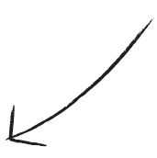
Our 11 criteria
to evaluate products
1
7
Less material
Have we used a lightweight construction in
the product?
Transport efficient
Is the product more transport efficient than the
predecessor, i.e. can we fit more in to the
container?
2
Renewable materials
How much of the product is made from
renewable materials?
8
Energy Use at Suppliers
Are the suppliers producing this product more
energy efficient than comparable suppliers in the
category?
3
Recycled materials
How much of the product is made from recycled
materials?
9
Renewable energy share at Suppliers
Do the suppliers producing this product use
energy from renewable sources?
4
Environmentally better materials
How much of the material in the product comes
from well managed sources or has a proven
lower environmental impact than the
“normal material”?
10
Raw-material utilization at Suppliers
How is the raw-material utilization (yield) at the
suppliers producing this product compared to
other suppliers on the market?
5
Separable and recyclable
Is the product separable and recyclable at
end of life?
11
Product use
Does this product help our customers to reduce
energy, water or waste in their homes?
6
Quality
How low is the COPQ?

Slide 22

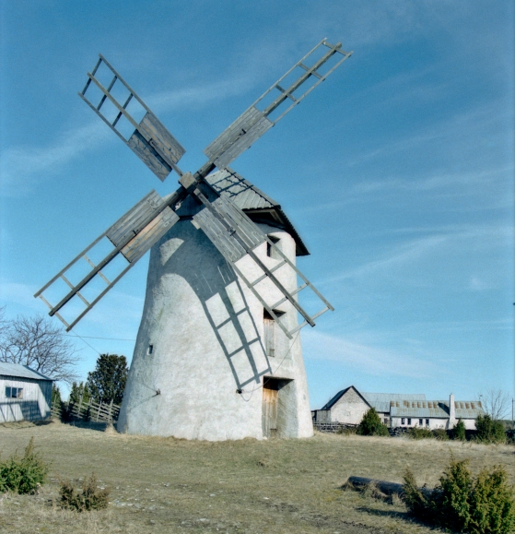
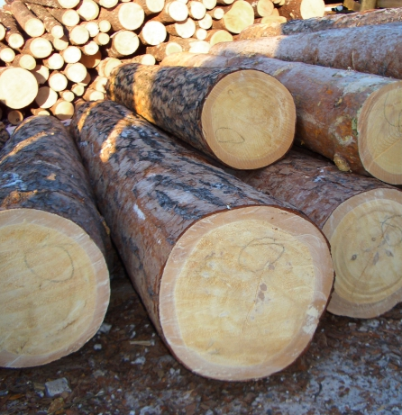
Supplier Sustainability Index
ENERGY USE
RENEWABLE ENERGY %
RAW MAT UTILISATION
Evaluates energy efficiency at supplier from an qualitative and quantitative perspective.
The share of renewable energy that the supplier is able to use. Depends on industry, country and chosen technology.
Evaluates basic manufacturing questions as well as manufacturing performance at supplier.
20% yearly relative improvement

Slide 23
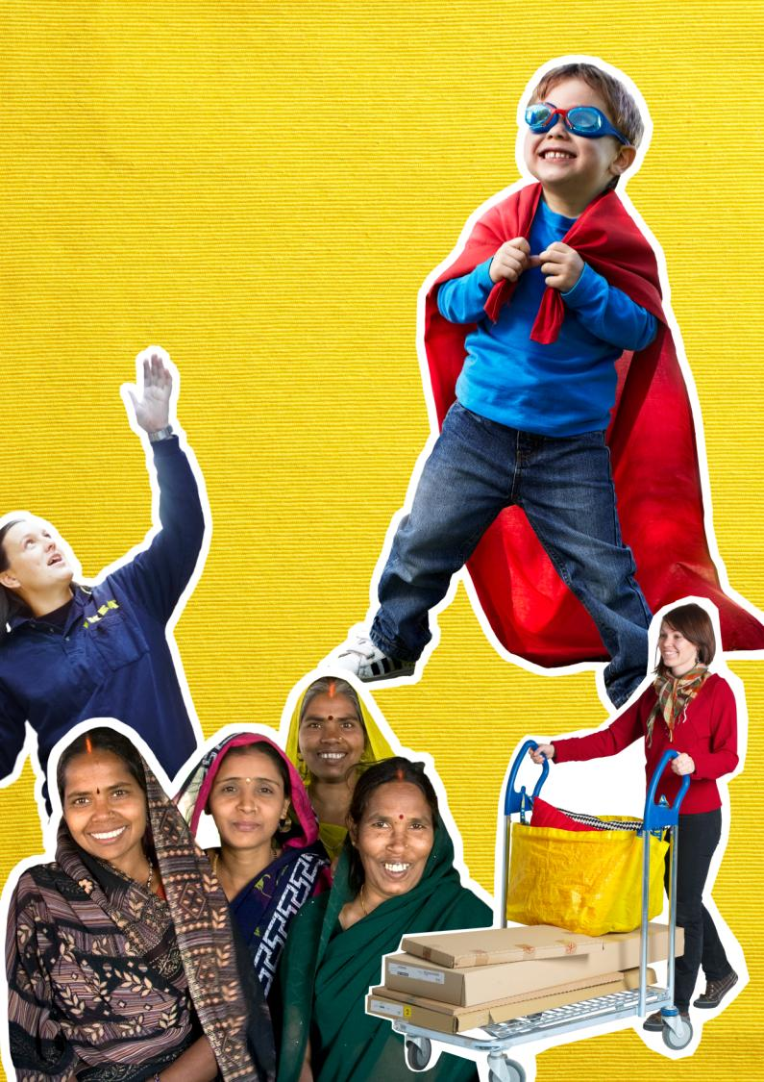
Together with
our operations and supplying world
BETTER
LIFE FOR
PEOPLE AND COMMUNITIES

Slide 24
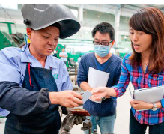
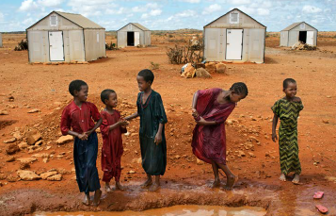
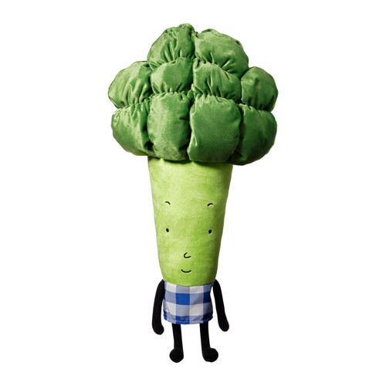
IKEA Foundation, donated
EUR 101 million 2013
IWAY – IKEA code
of conduct
Soft Toy Campaign

Slide 25
Better life for people and communities IWAY
IKEA WAY OF PURCHASING

Slide 26
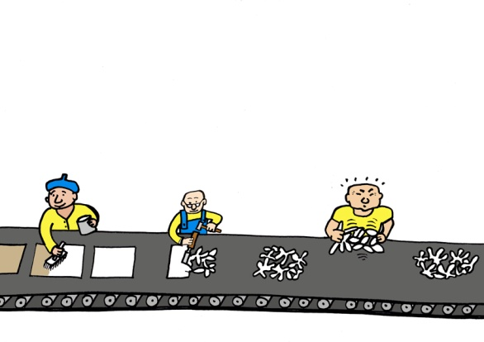
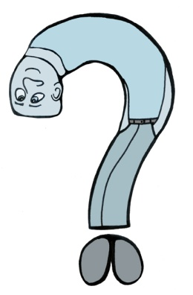
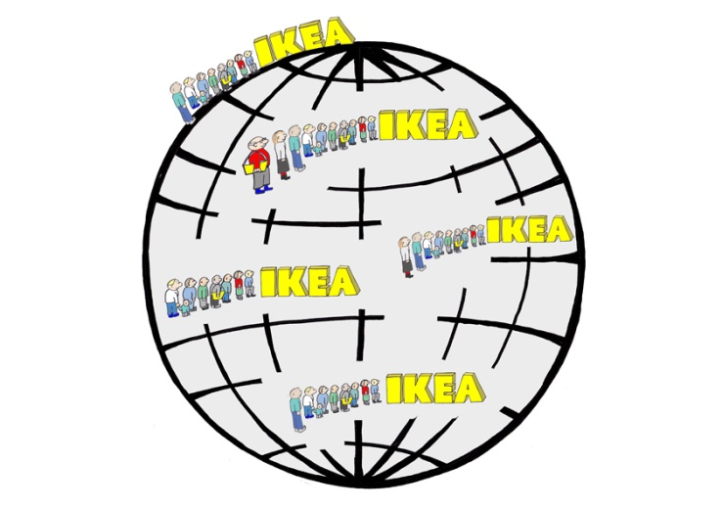
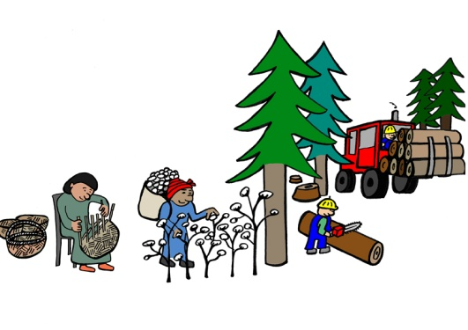

IKEA and people
>600,000 co-workers at IKEA suppliers
Co-workers at
tier 1 sub-suppliers
>690 million visitors
2 million people in
extended value chain
139,000 co-workers
Notes:
650 million visitors to STORES
Approx. 2 million people working in extended supply chain (home workers, cotton fields, forestry workers)
Questionmark (person shaped as question mark) no of people in tier 2 supply chain. 6600 Sub-Suppliers (second tier). Not include TAGC and TANE. Rough estimate- total tier 2: 10,000 Sub-Suppliers.
400,000-600,000 people working for tier 1 suppliers (mainly factories)
135,000 co-workers in IKEA (mainly in IKEA stores)

Slide 27

IWAY is a pre-condition for business
Start up Requirements (or IWAY Musts) must be fulfilled before a business agreement can be signed.
Full IWAY is required within maximum 12 months.
Valid for IKEA group members.
27
Notes:
99% comliance is probably what we can expect. We will likely have suppliers where we will find non-comliance to IWAY Must requirments and they will be in the process of correcting them.

Slide 28
To create
a better
everyday
life for
the many
people.
THANK YOU!
Notes:
Better – not just price, function & style, but sustainability and inspiring with solutions for a sustainable life at home.
The many – not just customers, but also our co-workers, suppliers, their co-workers and communities along the entire value chain- as well as future generations.

